Slide 1
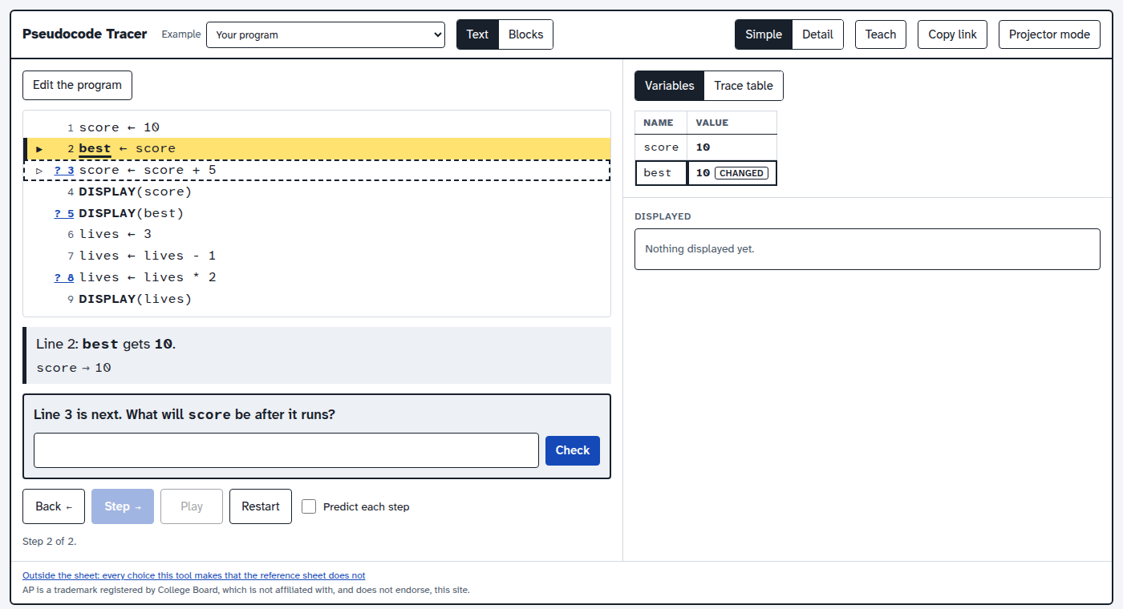
Pseudocode Tracer: Assignment Is a Copy
Grades 9-12 · 45 minutes
AP CSP Topics 3.1 and 3.3
Exam reference sheet notation
Slides, rubric and answer key
Notes:
Project this as students come in. The AP CSP exam asks students to trace code written in the exam reference sheet's own notation, and the very first rule they need is what the arrow does. The CED's own example (AAP-1.B.3) is a ← 1, b ← a, a ← 2, DISPLAY(b): it still displays 1, and many students say 2. In this lesson students trace short programs in a step-by-step tracer that runs the reference sheet's notation exactly. At the lines marked with a question mark, the tracer stops and asks what the variable will hold or what will be displayed, and checks the answer before it runs the line. Students find that assignment copies a value instead of linking two names, that a variable holds only its most recent value, why a swap needs a third variable, and how MOD and division work on the exam. They finish with exam-style questions whose wrong choices come from running each common mistake.

Slide 2
Essential question
When the reference sheet's arrow runs, what exactly does the variable on its left hold afterward?
Notes:
Read it aloud. Come back to it at the end of the lesson.

Slide 3
Today I can
1
I can determine the value of a variable after a sequence of assignments (AAP-1.B).
2
I can explain why assignment copies a value instead of linking two variables.
3
I can trace a swap and explain why it needs a third variable.
4
I can evaluate expressions with +, -, *, / and MOD as the reference sheet defines them (AAP-2.C).
Notes:
The objectives as I can statements. Read them aloud, and come back to them at the end of the lesson.

Slide 4
Warm-up
a ← 1, then b ← a, then a ← 2. What does DISPLAY(b) show, 1 or 2?
Notes:
Warm-up, minutes 0 to 7. Show the title, essential question and Today I can slides (about 1 minute). Write the CED's own example on the board: a ← 1, b ← a, a ← 2, DISPLAY(b). Ask everyone to vote with fingers, 1 or 2, and to say why. Do not settle it yet. Then have students open the link or scan the QR code on the worksheet, and hand out the exam reference sheet: this notation is the one on the exam.

Slide 5
Words we will use
variable
A name in a program that holds one value at a time. Giving it a new value replaces the old one.
assignment
The arrow, a ← expression: work out the expression, then store a copy of the result in a.
expression
Values, variables and operators that work out to one value, like score + 5.
MOD
The remainder after dividing: 17 MOD 5 is 2. On the exam, a MOD b uses a 0 or more and b more than 0.
trace
Following a program line by line and writing down what each variable holds.
trace table
A table with a column for each variable and a row each time something changes.
exam reference sheet
The pages of notation given to every student on the AP CSP exam. Every exam program uses it.
Notes:
Point at each word on the screen the first time the lesson uses it.

Slide 6
What the arrow does
Rule 1
Rule 2
Rule 3
Work out the right side first.
Store a copy of the result in the variable on the left.
A variable holds only its most recent value.
The CED's words: assignment "evaluates expression and then assigns a copy of the result" (AAP-1.B.2).
Notes:
Direct instruction (I do), minutes 7 to 15. Show the vocabulary and What the arrow does. On the projector, press Step through the starter program. Line 2, best ← score, copies 10 into best; the Variables panel marks best CHANGED. At line 3 the tracer stops: Line 3 is next. What will score be after it runs? Take answers from the room, type one in and press Check. If it is wrong, the tracer says Not yet. It was 15. and runs the line. At line 5 it asks what DISPLAY(best) will show: 10, because best got a copy of the old score, and changing score later did not touch it. Go back to the board: the warm-up displays 1, for the same reason. The CED says the variable "will be the most recent value assigned" (AAP-1.B.3).
It's working when: Step stops at a line with a ? in front of it and asks before the line runs; the answer box takes a number or text. Back steps back one line at a time, so a step can be watched again.

Slide 7
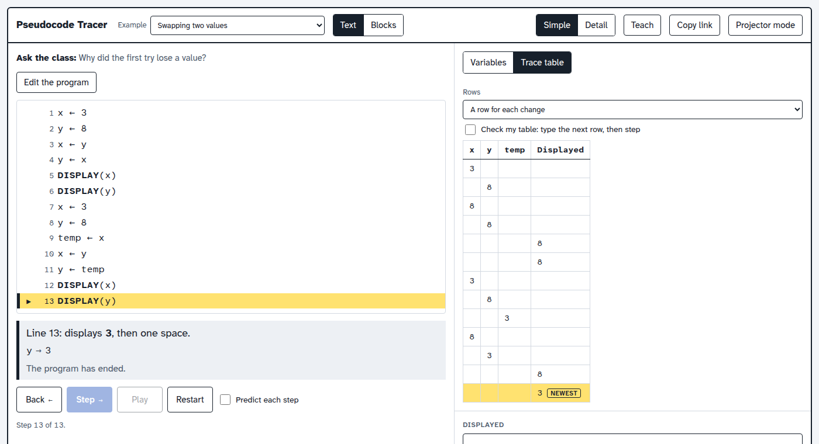
Swapping two values
The first try ends 8 and 8: the 3 was replaced before it was copied. With temp, it ends 8 and 3.
Notes:
Guided practice (We do), minutes 15 to 25. Students choose Example, then Swapping two values. Before stepping, they predict what the first try, lines 1 to 6, displays. Step together. The first try, x ← y then y ← x, displays 8 and 8: by the time y ← x runs, x already holds 8, and the 3 is gone. The second try saves x in temp first and displays 8 and 3. Open the Trace table tab (A row for each change) and compare it with the worksheet's table, row by row. Ask: what would happen with three variables to rotate?

Slide 8

Together: predict, then check
1
Press Step. A line marked ? stops and asks first.
2
Type your prediction and press Check.
3
Read Not yet carefully: it tells you what really happened.
Scan the QR code, or go to
mytekdev.com/try/pseudocode?lesson=assignment-is-a-copy
4
Write each row of the trace table as you go.

Slide 9
Exam-style practice
Rule 1
Rule 2
Rule 3
Example: Order of operations. Teach, Exam question.
Choose before you step. Then step to see why.
Do the same with A clock with MOD.
Each wrong choice is what a real mistake displays, worked out by running it.
Notes:
Independent practice (You do), minutes 25 to 38. Students choose Example, then Order of operations, and open Teach, then Exam question. The output and the steps stay covered until they choose. The right answer is 18 28 3 2.5. The other choice is 28 28 3 2.5, which is what the program displays if the operations are done left to right with no precedence; the tracer worked it out by running that mistake. The tracer offers only wrong choices that a real mistake produces, so here there are two; A choice of your own adds teacher-written choices, so a question can offer four like the exam's. After choosing, they step to see why. Then the same with A clock with MOD, whose answer is 1 (a reader who takes MOD as the quotient gets 0). Finish the worksheet's two written answers. Walk the room and ask the questions under What to look for.
Watch for: A student who expects 17 / 5 to be 3 is thinking of whole-number division in another language. On the exam, / is ordinary division: 17 / 5 is 3.4, and 10 / 4 is 2.5.
Watch for: Choosing a new Example replaces the program. The lesson's starter comes back by opening the worksheet link in a new tab.

Slide 10
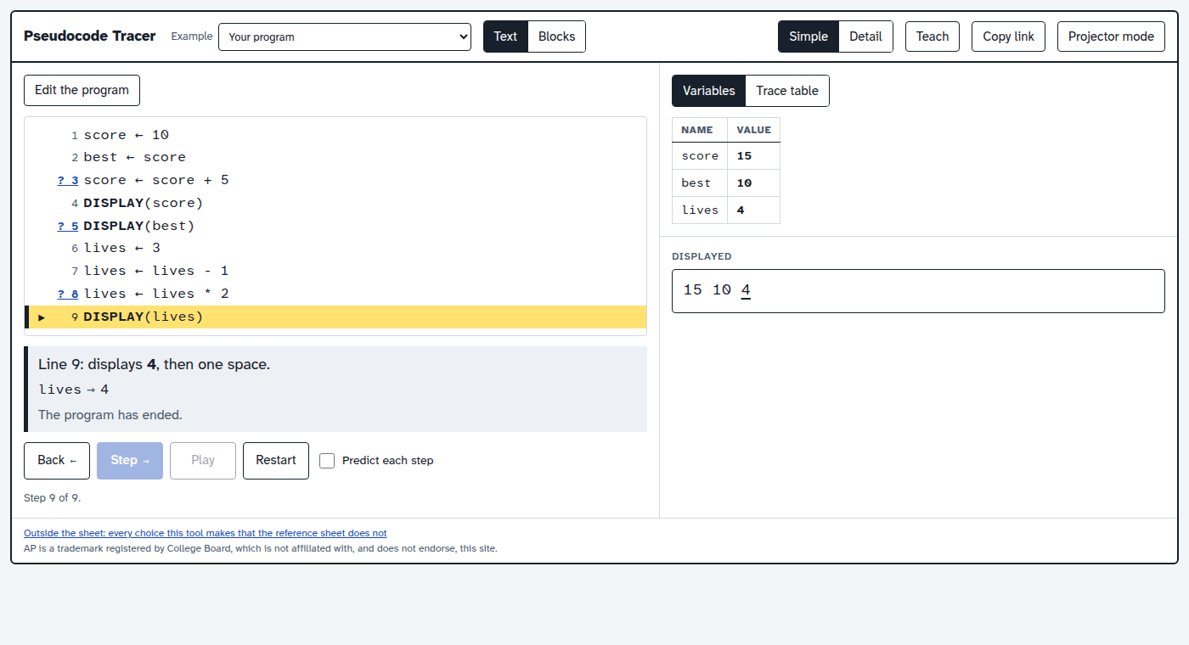
Explain it
After b ← a, why does changing a later leave b alone?
Notes:
Closure, minutes 38 to 45. Show the last slide and ask: "After b ← a, why does changing a later leave b alone?" (The arrow stored a copy of a's value in b at that moment. b and a are two separate variables, and each holds only its most recent value.) Ask the essential question again, then hand out the exit ticket.

Slide 11
Back to our question
When the reference sheet's arrow runs, what exactly does the variable on its left hold afterward?
Notes:
Ask the essential question again before the exit ticket.

Slide 12
Exit ticket
Answer on your own, on your exit ticket or in your notebook.
1. x ← 4, y ← x, x ← x + 3, y ← y * 2, DISPLAY(x), DISPLAY(y). What is displayed?
A. 7 8
B. 14 14
C. 7 14
2. What does DISPLAY(17 MOD 5) display?
A. 3
B. 3.4
C. 2
3. Explain why a swap of two variables needs a third variable.
Notes:
Hand out the exit ticket, or have students answer in their notebooks. The answer key is in the plan.

