Slide 1
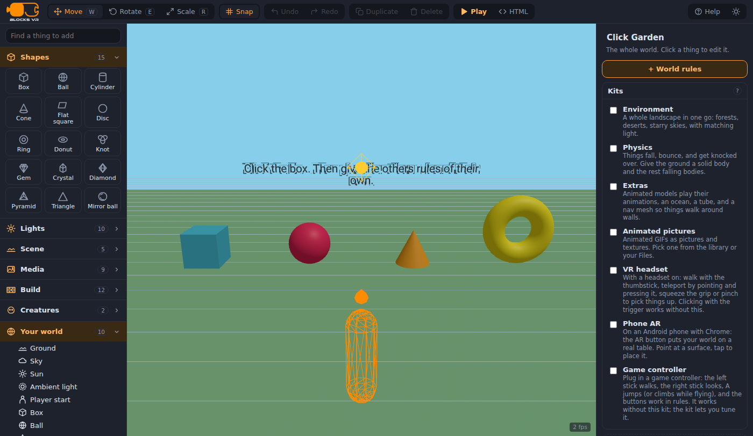
BlocksVR: Click to Change
Grades 4-7 · 45 minutes
Slides, rubric and answer key
Print and go
No student accounts
Notes:
Project this as students come in. In a small 3D garden, a box spins and changes color every time it is clicked. Students open its rules and find two plain sentences: always spin slowly, and when I get clicked, change to a random color. That is an event and an action. Then they give the other three things rules of their own, built from cards rather than typed code: a ball that grows, a cone that says hello, and a donut that counts clicks and shows You win at five. Along the way they find out why grow bigger only works once.

Slide 2
Essential question
How does a program know when to do something?
Notes:
Read it aloud. Come back to it at the end of the lesson.

Slide 3
Today I can
1
I can name the event and the action in a rule.
2
I can explain that a rule is checked over and over, and acts only when its event happens.
3
I can write rules from cards that make things respond to a click.
4
I can test a rule, notice when it does not do what was expected, and explain why.
Notes:
The objectives as I can statements. Read them aloud, and come back to them at the end of the lesson.

Slide 4
Warm-up
You click the box and it changes color. How does it know you clicked it?
Notes:
Warm-up, minutes 0 to 6. Show the title, essential question and Today I can slides (about 1 minute). Students open the link or scan the QR code on the worksheet. The world is a small garden with a box, a ball, a cone and a donut. A short guide runs along the top; students press Play, click the blue box a few times (drag to look around if they need to), and press Stop. Ask: "You clicked the box and it changed color. How does it know you clicked it?"

Slide 5
Words we will use
event
Something that happens, such as a click or a key press, that a program can notice.
action
What the program does when the event happens, such as changing color.
rule
A when and a do together: when this happens, do that.
program
The set of rules a thing follows.
bug
A program doing something different from what you meant.
score
A number the whole world keeps, which rules can add to and check.
Notes:
Point at each word on the screen the first time the lesson uses it.

Slide 6
The box's two rules
Rule 1
Rule 2
When always (every moment): spin slowly.
When I get clicked: change to a random color.
A rule is a When and what to do. The When is the event; the second part is the action.
Notes:
Direct instruction (I do), minutes 6 to 14. On the projector, click Box in the Your world list on the left (the guide's last step). In the panel on the right, the box's behavior card names its program, box; press Edit. The drawer opens on Rules: two cards, each a When menu, an arrow and a second menu. When always (every moment), then spin slowly. When I get clicked, then change to a random color. Name the parts: the When is the event, the menu after the arrow is the action, and together they are a rule. The program checks its rules over and over, many times a second, and the click rule acts only in the moment a click happens. Then switch to Code to show the same rules as code: spin(45), and if (wasClicked()) { setColor(randomColor()); }.

Slide 7
The same rules as code
Rule 1
Rule 2
Rule 3
spin(45);
if (wasClicked()) {
setColor(randomColor()); }
Rules, Easy Blocks, Blocks and Code all show the same program. This is the Code view.

Slide 8
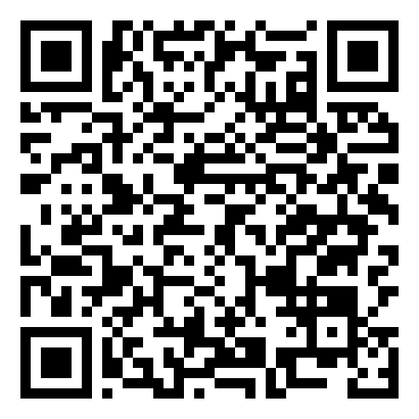
Together: the ball
1
Click Ball in the list. Press + Add behavior.
2
The rules open with the box's two rules.
3
Change its click rule to grow bigger.
Scan the QR code, or go to
mytekdev.com/try/blocksvr?lesson=click-to-change
4
Play. Click it twice. What happens?
Notes:
Guided practice (We do), minutes 14 to 22. Students click Ball in the list and press + Add behavior. The rules drawer opens on a new program that starts with the same two rules as the box. They change the click rule's second menu (what to do) to grow bigger, then Play and click the ball twice. It grows on the first click and not on the second. Ask why. Grow bigger means twice its normal size, not twice its size now, so a second click asks for a size it already has. That is a bug in the plan, not in the computer: the computer did exactly what the rule said. One fix: add a rule that sets it back, every 2 seconds, go back to normal size, so the next click can grow it again.

Slide 9
The cone and the donut
Rule 1
Rule 2
Rule 3
Cone: when I get clicked, say Hello!
Donut: when I get clicked, add 1 point.
Donut: when the score reaches 5, show You win!
Pick both menus on every new rule card.
Notes:
Independent practice (You do), minutes 22 to 38. Students give the cone a behavior and change its click rule to say Hello!. Then the donut: its click rule becomes add 1 point, and they press + Add a rule for a second card: When the score reaches 5, then show You win! after the arrow. On every new card they choose both menus, the When and the what-to-do; a new card does nothing until both have been chosen. They Play and click the donut five times: the score climbs, and the fifth click wins. Students who finish swap a When for a different event (the player is near me, every 2 seconds, the space bar is pressed) and predict the result before they Play. Walk the room and ask the questions under What to look for.

Slide 10
Your own event
Try a different When: the player is near me, every 2 seconds, or the space bar is pressed. What happens?

Slide 11
When to act
How does a program know when to do something?
Notes:
Closure, minutes 38 to 45. Ask the essential question again. From the class: a program keeps checking its rules, and a rule acts when its event happens; the same event can start different actions, and a rule does exactly what it says, which is not always what we meant. Then hand out the exit ticket.

Slide 12
Back to our question
How does a program know when to do something?
Notes:
Ask the essential question again before the exit ticket.

Slide 13
Exit ticket
Answer on your own, on your exit ticket or in your notebook.
1. In the rule "When I get clicked, do turn red", what is the event?
A. turn red
B. I get clicked
C. the rule
2. A ball has the rule "When I get clicked, do grow bigger." You click it three times. How big is it?
A. twice its normal size
B. eight times
C. normal size
3. Write a rule that makes something spin fast when the player is near it.
Notes:
Hand out the exit ticket, or have students answer in their notebooks. The answer key is in the plan.

