Slide 1
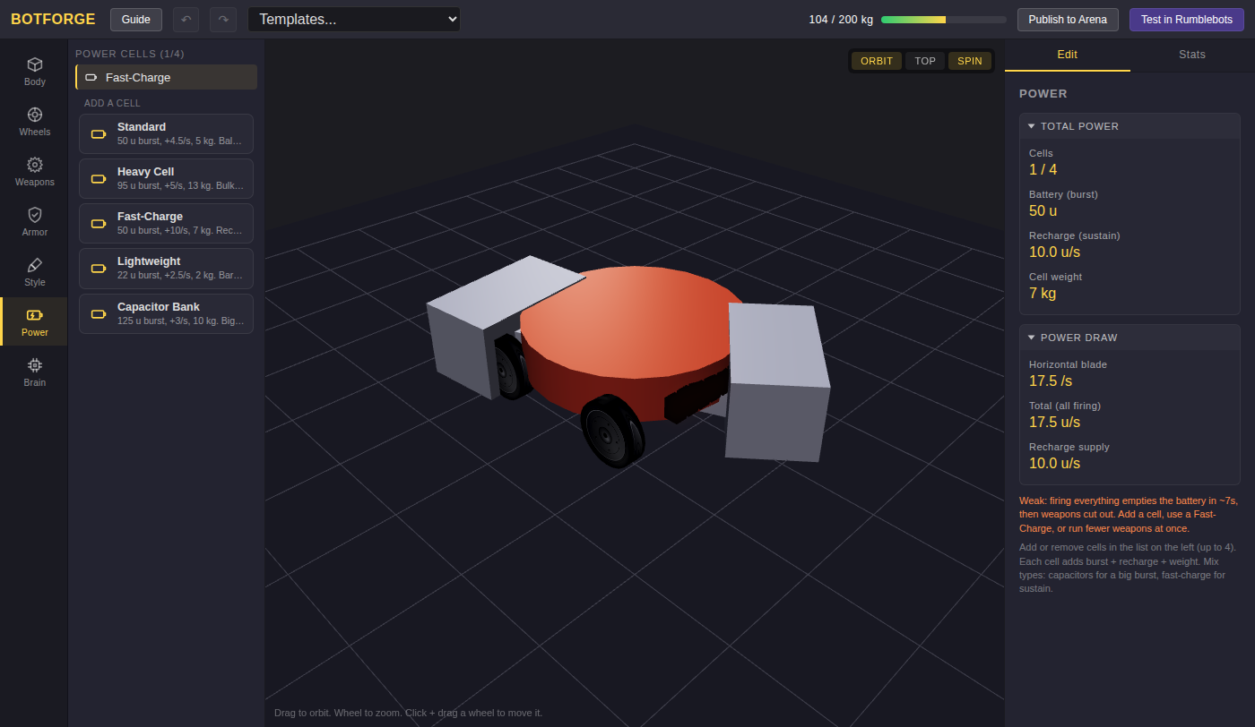
BotForge: Keep the Spinner Spinning
Grades 5-8 · 45 minutes
Slides, rubric and answer key
Print and go
No student accounts
Notes:
Project this as students come in. BotForge opens on a spinner bot whose blade empties its battery in under 7 seconds, and then cuts out mid-fight. Students read three numbers the app shows, the battery, its recharge and the blade's power draw, and work out the run time themselves: the battery divided by what is lost each second. Then they spend as little of the 200 kg weight limit as they can on battery cells that keep the blade spinning for at least 15 seconds.

Slide 2
Essential question
How long will a battery last, and how can a designer make it last longer?
Notes:
Read it aloud. Come back to it at the end of the lesson.

Slide 3
Today I can
1
I can find how much power a bot loses each second by subtracting its recharge from its weapons' draw.
2
I can work out how long a battery lasts by dividing what it holds by what it loses each second.
3
I can predict a bot's sustained run before checking it in the app.
4
I can choose battery cells that meet a run time while using as little of the weight limit as possible.
Notes:
The objectives as I can statements. Read them aloud, and come back to them at the end of the lesson.

Slide 4
Warm-up
The battery empties in about 7 seconds. What does that mean in a fight?
Notes:
Warm-up, minutes 0 to 7. Show the title, essential question and Today I can slides (about 1 minute). Then have students open the link or scan the QR code on the worksheet: BotForge opens on a spinner bot. A short guide runs along the bottom; tell students to do its first step only: press Power on the left. The panel on the right warns: firing everything empties the battery in about 7 seconds, then weapons cut out. Ask: "What does that mean in a fight?"

Slide 5
Words we will use
battery
How much power the bot holds, counted in units (u). A full battery is the most it can spend at once.
recharge
How much power the battery gets back every second (u/s).
power draw
How much power the weapons use every second while they fire (u/s).
rate
How much of something happens each second, like 7.5 units lost per second.
brown out
When the battery runs empty and the weapons cut out until it fills again.
sustained run
How long the weapons can fire nonstop before the battery runs empty.
trade-off
Giving up some of one thing to get more of another, like weight for power.
Notes:
Point at each word on the screen the first time the lesson uses it.

Slide 6
Three numbers
50 u
10 u/s
17.5 u/s
battery: what it holds
recharge: what comes back each second
draw: what the blade uses each second
The blade uses more each second than the battery gets back.
Notes:
Direct instruction (I do), minutes 7 to 15. Show the vocabulary slide. Then point to the three numbers in the Power panel: Battery (burst) 50 u, Recharge (sustain) 10.0 u/s, and under Power draw, Total (all firing) 17.5 u/s. Say: every second the blade uses 17.5 and the battery gets 10 back, so it loses 17.5 - 10 = 7.5 every second. The battery holds 50, so it lasts 50 / 7.5, about 6.7 seconds. Open Stats at the top right and find Sustained run: 6.7s. Say: if the recharge were 17.5 or more, nothing would be lost, and the Stats would say unlimited. Show the cells slide: each cell in Add a cell lists its burst, its recharge and its weight, and the meter at the top shows the whole bot, 104 of 200 kg.

Slide 7
How long it lasts
7.5 u/s
6.7 s
lost each second: 17.5 - 10
50 / 7.5: the sustained run
If the recharge is as big as the draw, nothing is lost, and it runs forever.

Slide 8
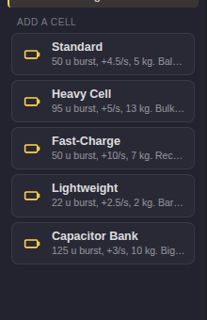
Every cell has a weight
Each cell adds battery, recharge and weight. The whole bot must weigh 200 kg or less.

Slide 9

Together: predict, then check
1
Swap the Fast-Charge for a Standard cell.
2
Work out: 50 / (17.5 - 4.5).
3
Write your answer, then open Stats.
Scan the QR code, or go to
mytekdev.com/try/botforge?lesson=keep-the-spinner-spinning
4
Compare Sustained run with your answer.
Notes:
Guided practice (We do), minutes 15 to 23. Together: press Power, add a Standard cell from Add a cell, then delete the Fast-Charge with the delete control on its row (a bot always keeps at least one cell). Before anyone opens Stats, students work out the new run: 50 / (17.5 - 4.5) = 50 / 13, about 3.8 seconds, and write it down. Then open Stats: Sustained run 3.8s. Then add a second Standard cell and predict again: 100 / (17.5 - 9) = 100 / 8.5, about 11.8 seconds. Before moving on, check that every worksheet has both predictions and both checks.

Slide 10
The lightest 15 seconds
Rule 1
Rule 2
Rule 3
Sustained run of 15 seconds or more.
Cells that weigh as little as you can.
Work it out first, then check in Stats.
Every kilogram you save is a kilogram for armor or a bigger weapon.
Notes:
Independent practice (You do), minutes 23 to 37. Walk the room and ask the questions under What to look for. Students find cells that give a sustained run of 15 seconds or more while weighing as little as possible (Cell weight is in the Power panel), working each try out on paper before checking it in Stats. Up to four cells fit. The lightest answers weigh 11 kg: Fast-Charge plus two Lightweight cells (37.6 seconds), or three Lightweight plus one Standard (21.1 seconds). Students who finish find the lightest cells that never brown out (Sustained run says unlimited): Fast-Charge plus three Lightweight cells, 13 kg, recharge 17.5, exactly the draw.

Slide 11
Compare
Who found the lightest cells? Why not just add four Heavy Cells?
Notes:
Closure, minutes 37 to 45. Collect the lightest answers on the board and ask: "Why not just add four Heavy Cells?" (They weigh 52 kg, more than a quarter of the 200 kg limit, and every kilogram spent on cells cannot go to armor or a bigger weapon.) Ask the essential question again, then hand out the exit ticket.

Slide 12
Back to our question
How long will a battery last, and how can a designer make it last longer?
Notes:
Ask the essential question again before the exit ticket.

Slide 13
Exit ticket
Answer on your own, on your exit ticket or in your notebook.
1. A battery holds 100 u, recharges 10 u/s, and the weapons draw 15 u/s. How long do the weapons last?
A. 20 seconds
B. 10 seconds
C. 6.7 seconds
2. The recharge is 20 u/s and the weapons draw 17.5 u/s. The sustained run is:
A. 2.5 seconds
B. 37.5 seconds
C. unlimited
3. Name two ways to make a spinner's battery last longer, and what each one costs.
Notes:
Hand out the exit ticket, or have students answer in their notebooks. The answer key is in the plan.

