Slide 1
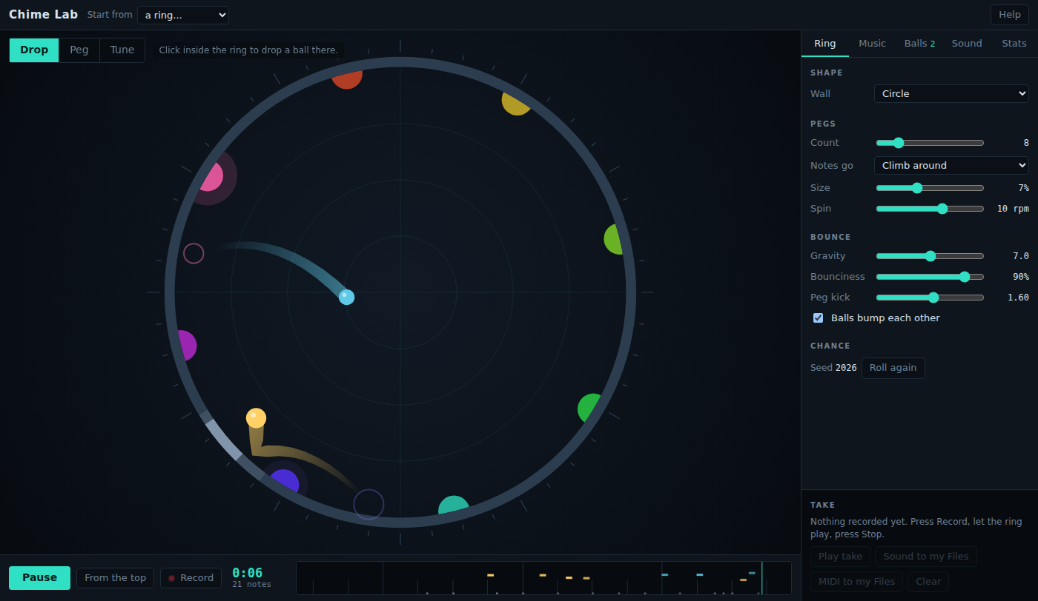
Chime Lab: Same Bounces, Different Mood
Grades 4-6 · 45 minutes
Slides, rubric and answer key
Print and go
No student accounts
Notes:
Project this as students come in. Eight pegs around a ring play one octave of C, and two balls bounce off them. Students switch the scale from Major to Minor and back while it plays: the balls bounce exactly the same way, but the music changes mood. They find out which notes changed, compare five scales with words for how each one feels, count how many notes each scale has, and then set up a ring to fit a mood card, record a take, and have a partner guess the mood.

Slide 2
Essential question
How can the same rhythm feel happy, sad or spooky?
Notes:
Read it aloud. Come back to it at the end of the lesson.

Slide 3
Today I can
1
I can explain that a scale is the set of notes a piece of music uses.
2
I can name the notes that change between the major and minor scales on C.
3
I can describe the mood of several scales with specific words, and compare them.
4
I can choose a scale, tempo and sound to fit a mood, and explain the choices.
Notes:
The objectives as I can statements. Read them aloud, and come back to them at the end of the lesson.

Slide 4
Warm-up
Listen. What word would you use for how this music feels?
Notes:
Warm-up, minutes 0 to 6. Show the title, essential question and Today I can slides (about 1 minute). Students open the link or scan the QR code on the worksheet, with headphones on. The ring has eight pegs that play one octave of C, from low C at the bottom up to high C. A short guide runs along the top; have students do its first step only (Play). Ask: "What word would you use for how this music feels?" Collect words on the board.

Slide 5
Words we will use
scale
The set of notes a piece of music uses, in order from low to high.
major
A scale that usually sounds bright or happy.
minor
A scale that usually sounds darker or sad. On C it lowers three notes of the major scale.
octave
From one note up to the next note with the same name, such as C to the next C.
pentatonic
A scale with five notes in each octave. Almost any order of its notes sounds pleasant.
mood
The feeling a piece of music gives the listener.
tempo
How fast the beat goes, in beats per minute.
Notes:
Point at each word on the screen the first time the lesson uses it.

Slide 6
Major and minor on C
C D E F G A B C
C D D# F G G# A# C
Major
Minor
Three notes move down: E, A and B. The app names the black keys with sharps, so D# is the same key as E-flat.
Notes:
Direct instruction (I do), minutes 6 to 14. On the projector, finish the guide: open Music and change Scale from Major to Minor while it plays. Ask for new mood words. Explain that a scale is the set of notes the music uses, and that the ring's pegs always play notes from the scale, so changing the scale retunes every peg at once. Show the two scales on the board (and on a keyboard if you have one): Major on C is C D E F G A B C; Minor on C is C D D# F G G# A# C. Three notes move down: E, A and B. The app names black keys with sharps, so D# is E-flat, G# is A-flat and A# is B-flat. Then press From the top in both scales: the balls bounce exactly the same way, hitting the same pegs at the same moments. Only the notes changed, and the mood changed with them.

Slide 7
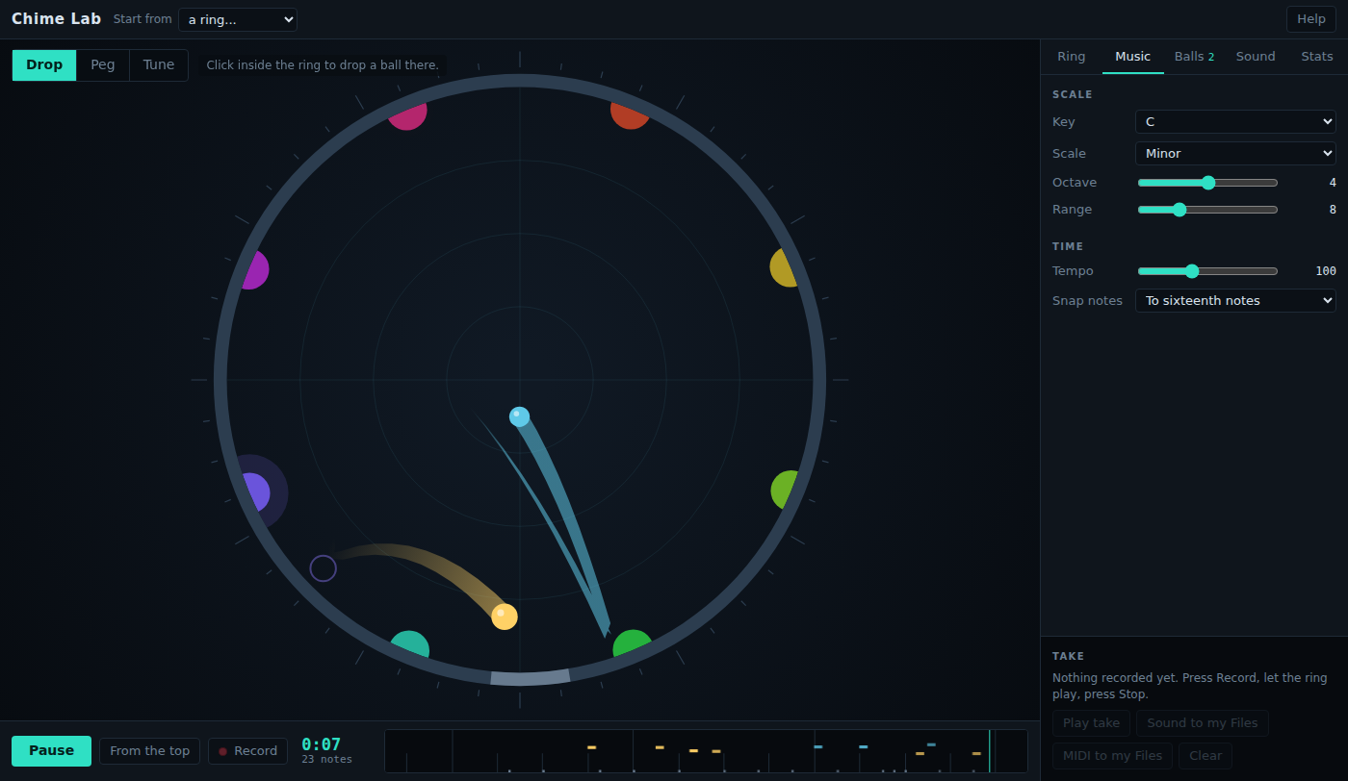
Only the notes change
Scale is on the Music tab. The balls bounce exactly as before: same pegs, same times, new notes.

Slide 8

Together: five scales
1
Press From the top (Play, if it is paused).
2
Pick a scale and listen for 20 seconds.
3
Write one mood word for it.
Scan the QR code, or go to
mytekdev.com/try/chimelab?lesson=same-bounces-different-mood
4
Count its notes in one octave.
Notes:
Guided practice (We do), minutes 14 to 24. Students press From the top (and Play, if the ring is paused) and listen to each of five scales for about 20 seconds: Major, Minor, Major pentatonic, Blues and Hirajoshi. For each, they write a mood word and count the notes in one octave. They can read the notes in Stats, where each peg is listed by its note (W1 C, W2 D, and so on). Compare as a class: Major and Minor have 7 notes in an octave, Blues has 6, Major pentatonic and Hirajoshi have 5. Ask why the pentatonic never seems to play a wrong note: with only five notes, spread apart, no two neighbors clash.

Slide 9
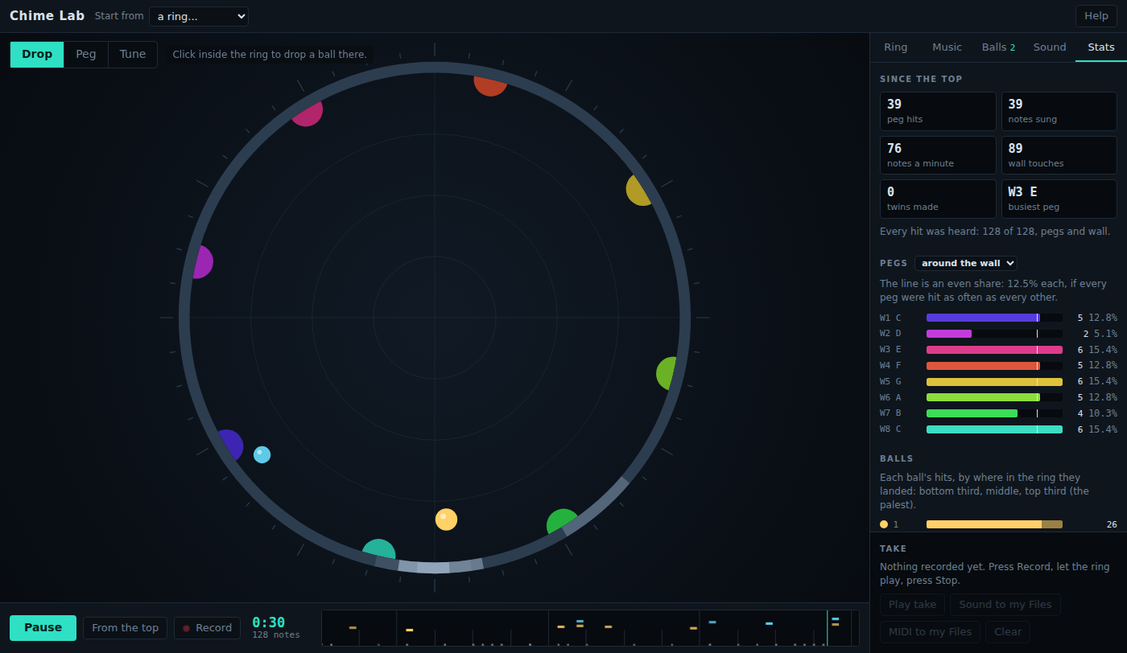
Which notes did the pegs play?
Stats lists the pegs by note: W1 C, W2 D, W3 E. Change the scale and the names change.

Slide 10
Match a mood
Rule 1
Rule 2
Rule 3
Pick a mood card. Do not show anyone.
Choose the scale, sounds and gravity that fit it.
Record a take. Can a partner guess your mood?
Write why you chose each setting.
Notes:
Independent practice (You do), minutes 24 to 38. Each student or pair takes a mood card (a lullaby, a spooky hallway, a sunny morning, a race, rain on a window) without showing it. They choose the Scale on the Music tab, a sound for each ball on the Balls tab, and Gravity on the Ring tab: less gravity means slower, gentler bounces and fewer notes, more gravity faster and busier ones. Tempo on the Music tab does not change the bounces; it sets the beat the notes snap to (with Snap notes on) and the echo, so it changes the feel of the rhythm rather than how many notes there are. They write why they chose each setting. They press From the top, then Record, let it play for 20 to 30 seconds, and press Stop (the Record button's label while recording); Play take plays it back. A partner listens and guesses the mood. Walk the room and ask the questions under What to look for.

Slide 11
Same bounces, different mood
How can the same rhythm feel happy, sad or spooky?
Notes:
Closure, minutes 38 to 45. Ask the essential question again. From the class: the rhythm comes from the bounces, the mood comes mostly from the notes the scale allows, and tempo and sound change it too. Then hand out the exit ticket.

Slide 12
Back to our question
How can the same rhythm feel happy, sad or spooky?
Notes:
Ask the essential question again before the exit ticket.

Slide 13
Exit ticket
Answer on your own, on your exit ticket or in your notebook.
1. You change Scale from Major to Minor. What changes?
A. where the balls bounce
B. which notes the pegs play
C. how fast the balls fall
2. How many notes are in one octave of the Major pentatonic scale?
A. 5
B. 7
C. 12
3. Name two settings you chose for your mood card, and how each one helped the mood.
Notes:
Hand out the exit ticket, or have students answer in their notebooks. The answer key is in the plan.

