Slide 1
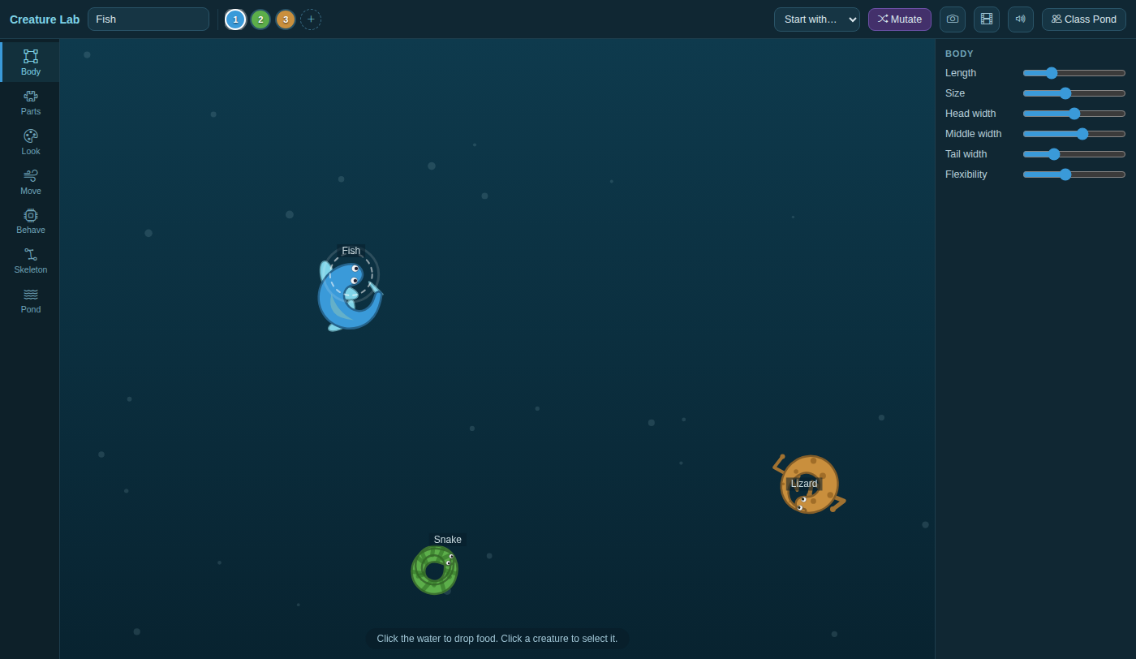
Creature Lab: How Far Can a Body Bend?
Grades 4-8 · 45 minutes
Slides, rubric and answer key
Print and go
No student accounts
Notes:
Project this as students come in. Three creatures circle in a pond: a snake coils into a ring, a lizard just closes one, and a fish only makes a C. Students look under the skin and find that each body is a chain of joints, every joint following the one ahead and bending only so far. They add up the angles, predict which bodies can curl all the way around, and then find how flexible the fish must be to close its ring.

Slide 2
Essential question
How can one small rule make a whole body move?
Notes:
Read it aloud. Come back to it at the end of the lesson.

Slide 3
Today I can
1
I can describe a creature's body as a chain of joints that each follow the joint ahead.
2
I can add the bend at each joint to find how far the whole body can bend.
3
I can predict whether a body can curl into a full circle (360 degrees), then test the prediction.
4
I can change a creature's flexibility or length so that it can curl all the way around.
Notes:
The objectives as I can statements. Read them aloud, and come back to them at the end of the lesson.

Slide 4
Warm-up
All three swim in a tight circle. Why can't the fish make a ring?
Notes:
Warm-up, minutes 0 to 7. Show the title, essential question and Today I can slides (about 1 minute). Then have students open the link or scan the QR code on the worksheet. Three creatures, a fish, a snake and a lizard, swim in tight circles: each one's brain says drift slowly and keep curving right, as hard as it can. A short guide runs along the bottom; tell students to do its first step only, then wait. Ask: "All three swim in a tight circle. Why can't the fish make a ring?"

Slide 5
Words we will use
joint
One of the dots in a creature's skeleton. Each joint follows the one in front of it.
chain
Joints joined one after another, like the links of a necklace.
rule
An instruction a computer follows every time. Here: stay the same distance behind the joint ahead.
angle
How much something turns, measured in degrees. A full turn is 360 degrees.
bend
The angle between two links of the chain. Each joint can bend only so far.
flexibility
How far each joint can bend. Low is stiff, like a fish; high is floppy, like a snake.
Notes:
Point at each word on the screen the first time the lesson uses it.

Slide 6
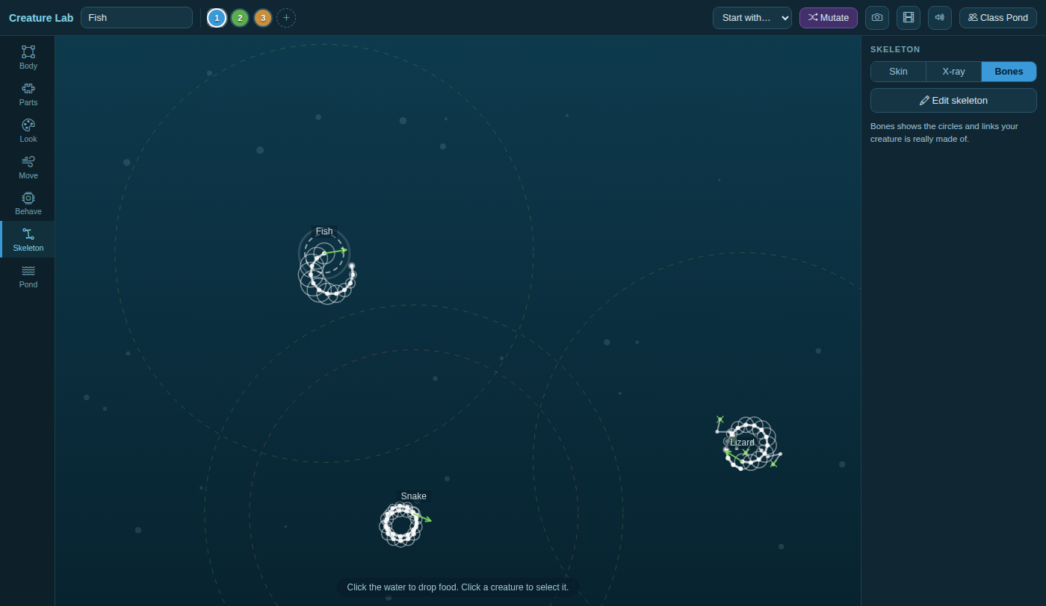
Under the skin: a chain
Every dot follows the dot ahead and stays the same distance behind it. That one rule moves the whole body.
Notes:
Direct instruction (I do), minutes 7 to 15. Show the vocabulary slide. Then, on the projector, open Skeleton in the rail on the left and pick Bones: each creature is a chain of dots. Say the rule: every dot follows the dot ahead and stays the same distance behind it, and that one rule, repeated down the chain, is the whole animation. Then show that each joint can bend only so far: open Body and point to Flexibility, which runs from about 13 degrees per joint at the left to about 42 at the right. Work the fish on the board: 12 joints make 11 bends; at its flexibility each bends about 24 degrees; 11 x 24 = 264 degrees, less than the 360 of a full circle, so the fish cannot close a ring however hard it turns.
Watch for: Students multiply by the joints: 12 x 24 = 288. The bends are the gaps between the dots, so there is one fewer bend than joints.

Slide 7
Each joint bends only so far
13°
42°
Flexibility all the way left
Flexibility all the way right
The bends add up. 360 degrees is a full circle.

Slide 8
Add up the fish
11 bends
11 x 24° = 264°
12 joints make 11 bends
less than 360°: no ring
The fish can curl only about three quarters of the way around.

Slide 9

Together: predict, then look
1
Work out the snake's bend: 25 bends x 29°.
2
Work out the lizard's: 15 bends x 26°.
3
Predict: which ones make a full ring?
Scan the QR code, or go to
mytekdev.com/try/creaturelab?lesson=how-far-can-a-body-bend
4
Open Skeleton and pick Bones. Were you right?
Notes:
Guided practice (We do), minutes 15 to 23. Together, students work out the snake (26 joints, so 25 bends, at about 29 degrees: 25 x 29 = 725 degrees, two whole circles) and the lizard (16 joints, so 15 bends, at about 26 degrees: 15 x 26 = 390 degrees, just over one circle). They write yes or no for a full ring before looking. Then everyone looks in Bones: the snake's bend adds up to about two circles, so it wraps around on itself; the lizard just closes its ring; the fish makes a C. Before moving on, check that every table has all three rows.

Slide 10
Close the fish's ring
Rule 1
Rule 2
Rule 3
Pick the fish. Open Body.
Change Flexibility or Length, one at a time.
Find a fish that curls all the way around.
Work out the bend first, then check it in Bones.
Notes:
Independent practice (You do), minutes 23 to 37. Walk the room and ask the questions under What to look for. Students select the fish (click it, or its number at the top), open Body and change one slider at a time: Flexibility (to the right) or Length (more joints). After each change they count the joints (the dots in Bones), read the degrees per joint from the slider table on the worksheet, work out the new total, and check it in Bones. A fish curls all the way around once its total passes 360: at its length, Flexibility about seven tenths of the way along, where each joint bends about 33 degrees (11 x 33 = 363); or at its flexibility, about 16 joints (15 x 24 = 360). Students who finish make the stiffest fish that still closes its ring.
Watch for: `Length` has disappeared from Body: the student pressed `Edit skeleton`, which hides the simple sliders. `Reset to sliders` brings them back.
Watch for: The slider changed the snake or the lizard. Body changes only the selected creature: click 1 at the top and check the name box says Fish.

Slide 11
One rule
How can one small rule make a whole body move?
Notes:
Closure, minutes 37 to 45. Ask the essential question again: one rule, follow the joint ahead and bend no more than so far, repeated for every joint, makes swimming, slithering and coiling. Then hand out the exit ticket.

Slide 12
Back to our question
How can one small rule make a whole body move?
Notes:
Ask the essential question again before the exit ticket.

Slide 13
Exit ticket
Answer on your own, on your exit ticket or in your notebook.
1. A creature has 10 joints. How many bends does it have?
A. 10
B. 9
C. 11
2. A creature has 20 bends, and each can bend 20 degrees. Can it curl into a full circle?
A. yes: 400 degrees is more than 360
B. no: 40 degrees is too little
C. no: 20 is less than 360
3. A fish cannot close its ring. Name two different changes that could help, and say why each one works.
Notes:
Hand out the exit ticket, or have students answer in their notebooks. The answer key is in the plan.

