Slide 1
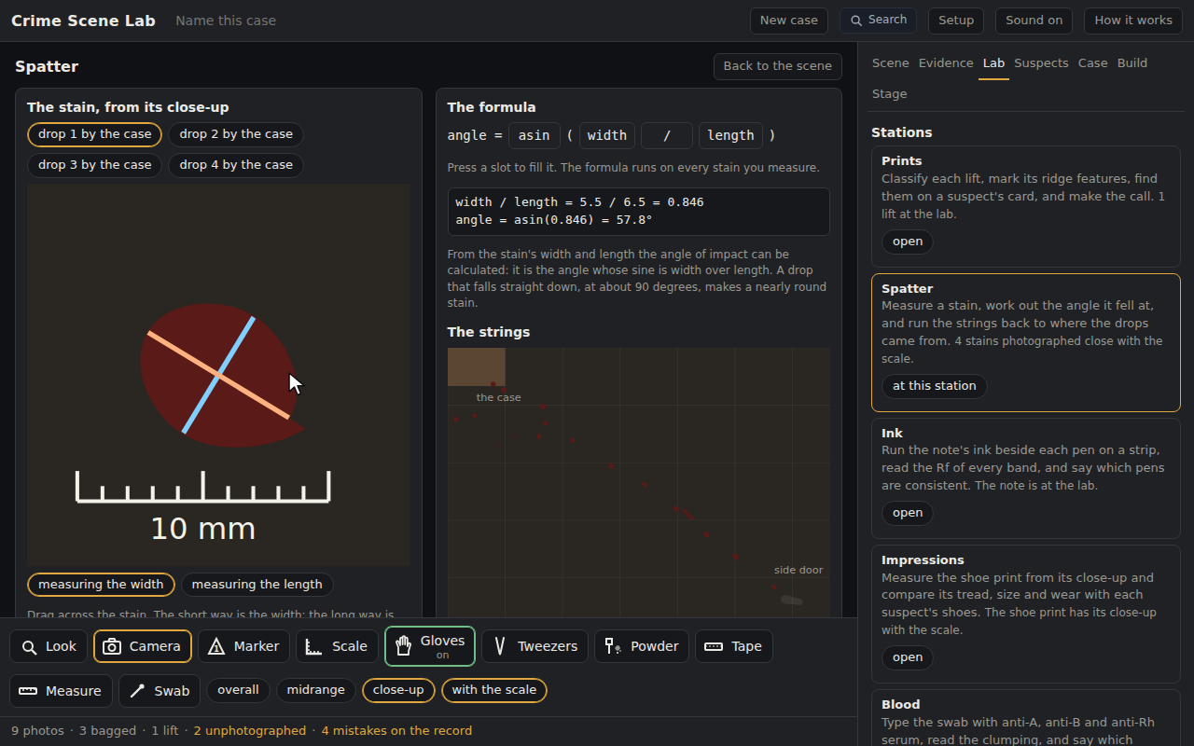
Crime Scene Lab: Blood Drops and the Angle of Impact
Grades 9-12 · 50 minutes
Slides, rubric and answer key
Print and go
No student accounts
Notes:
Project this as students come in. Eight stains on the floor of a virtual crime scene already have their close-up with the scale. Students measure each stain's width and length with a caliper, build the formula for the angle of impact from chips, asin(width / length), and read the working. They drag strings along the drops by the trophy case and watch them cross where the drops came from, then use the angles and the distance to estimate the height of the hand. The round drops fell straight down; the trail to the door came from a hand on the move.

Slide 2
Essential question
What can the shape of a drop tell you about where it came from?
Notes:
Read it aloud. Come back to it at the end of the lesson.

Slide 3
Today I can
1
I can measure a stain's width and length and compute the angle of impact as the inverse sine of their ratio.
2
I can say what the shape of a stain means: round from straight down, elongated from a low angle, the tail in the direction of travel.
3
I can run strings along the long axes of several drops to find where they came from, and estimate the height from the angle and the distance.
4
I can say what a drip trail can and cannot tell an investigator.
Notes:
The objectives as I can statements. Read them aloud, and come back to them at the end of the lesson.

Slide 4
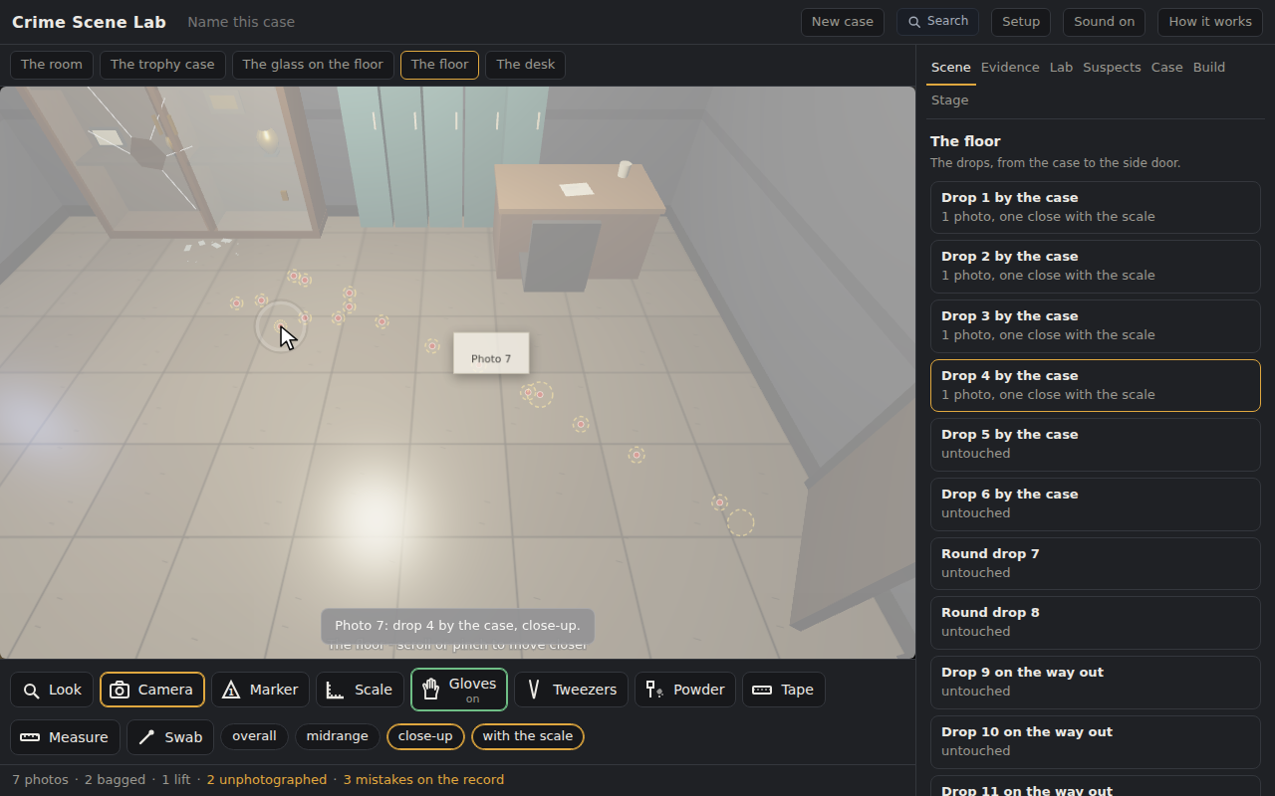
Warm-up
One stain is a circle. Another is three times as long as it is wide, with a tail. Which drop fell straight down?
Notes:
Warm-up, minutes 0 to 5. Show the title, essential question and Today I can slides (about 1 minute). Then the warm-up: project the floor view. Ask which drop fell straight down and what the long one tells them. Write the words they use on the board: fast, sideways, moving.
The circle. Let students say what the long one tells them before anyone says angle.

Slide 5
Words we will use
Angle of impact
The angle at which a drop struck the surface. Its sine is the stain's width over its length.
Area of convergence
Where lines through the long axes of the stains cross: where the drops came from, on the floor.
Area of origin
The convergence with the height added, from the angles and the distances.
Tail
The pointed end of an elongated stain, pointing the way the drop was moving.
Passive stain
A drop that fell under gravity alone, like the round drops by the case.
Notes:
Point at each word on the screen the first time the lesson uses it.

Slide 6
Width, length, angle
Width: the short way across
Length: the long way, the oval only, without the tail
The angle whose sine is width over length
5 mm wide and 15 mm long: 5 over 15 is 0.33, and the angle is about 19 degrees.
Notes:
Direct instruction (I do), minutes 5 to 13. Show Width, length, angle. Project the app with the starter open, Lab tab, Spatter station. Drag across the first stain: the width appears. Drag along it: the length. Press each slot of the formula and fill it: asin, width, over, length. Read the working aloud and do the division and the inverse sine by hand on the board. Show Three shapes.
It's working when: Build the formula wrong once, acos instead of asin, and read the number it gives. The formula runs on every stain, so a wrong formula is wrong everywhere, visibly.

Slide 7
Three shapes
90°
45°
15°
straight down: almost a circle
a stain about 1.4 times as long as wide
a long thin stain with a tail
The tail points the way the drop was moving.

Slide 8

Together: one stain
1
Lab tab, Spatter station, the first stain
2
Drag across for the width; drag along for the length
3
Build the formula: asin ( width / length )
Scan the QR code, or go to
mytekdev.com/try/crimescenelab?lesson=blood-drops-and-the-angle-of-impact
4
Read the working, and check it by hand
Notes:
Guided practice (We do), minutes 13 to 23. Have students open the link or scan the QR code. Together: the Lab tab, the Spatter station, the first stain's width and length, the formula built from chips, the working read. Every student figures the angle by hand on the worksheet before reading the app's. Check that the hand answers are within a couple of degrees of the app before moving on.
Watch for: Students who measure the length with the tail in, or the width at the tail's end. Either reads the angle too low; the check after hand-in says which reading was off and works the true angle out. Let it.

Slide 9
Four more stains, then the strings
Rule 1
Rule 2
Rule 3
Measure four more stains; figure each angle by hand first
Drag a string along three of the drops by the case
Read where they cross, and the height the app estimates
Then one drop on the way to the door: what does its tail say?
Notes:
Independent practice (You do), minutes 23 to 42. Students measure four more stains on their own, angle by hand first, then drag strings along three of the drops by the case on the floor plan under the formula, read the crossing and the height. Then one drop on the way to the door: its tail. Walk the room with the What to look for questions.
If they ask: "The drops on the way to the door all have tails pointing the same way. Who do they point at?" The trail

Slide 10
Showcase
Where did the drops by the case come from, how high was the hand, and how do you know?
Notes:
Closure, minutes 42 to 50. Show the Showcase slide. Two students report the crossing and the height with their reasoning. Answer the trail question together: where, not who. Hand out the exit ticket.

Slide 11
Back to our question
What can the shape of a drop tell you about where it came from?
Notes:
Ask the essential question again before the exit ticket.

Slide 12
Exit ticket
Answer on your own, on your exit ticket or in your notebook.
1. A stain is 4 mm wide and 8 mm long. Its angle of impact is about:
A. 30 degrees
B. 45 degrees
C. 60 degrees
2. Lines through the long axes of several stains cross at:
A. the area of convergence
B. the tail
C. the area of origin
3. Draw a stain that came in low, mark its tail, and say which way the drop was moving.
Notes:
Hand out the exit ticket, or have students answer in their notebooks. The answer key is in the plan.

