Slide 1
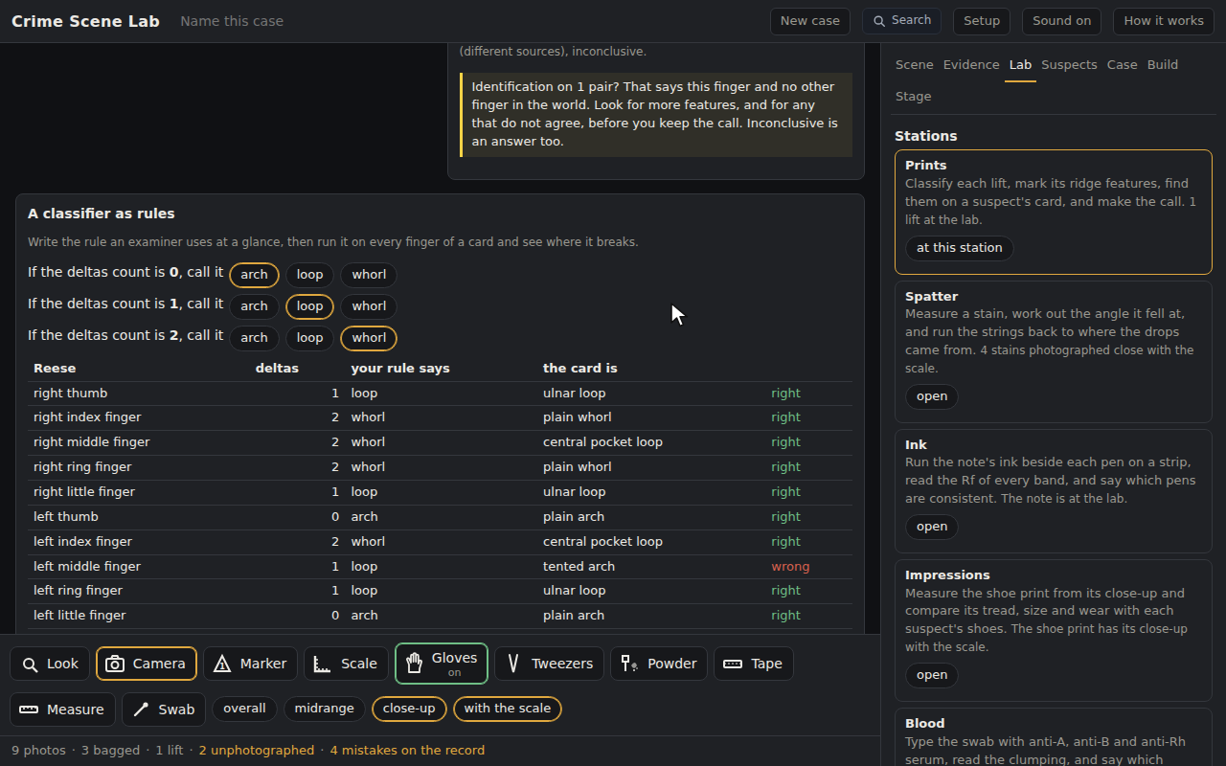
Crime Scene Lab: Fingerprints, Classify, Compare, Call It
Grades 6-12 · 45 minutes
Slides, rubric and answer key
Print and go
No student accounts
Notes:
Project this as students come in. Two prints have already been lifted from the broken pane and sent to the lab. Students classify each by counting its deltas, mark the ridge features they can see, pick a suspect and a finger, find the same features on the card and pair them, and make the call in the words an examiner uses. One lift is clean; the other is small and smudged, and it may never give enough. Then they write the classifier as three rules and run it on a whole card to see where it breaks.

Slide 2
Essential question
How many matching features make a fingerprint match?
Notes:
Read it aloud. Come back to it at the end of the lesson.

Slide 3
Today I can
1
I can classify a print as an arch, a loop or a whorl by counting its deltas, and at high school name its class in the eight-class scheme.
2
I can mark ridge endings, bifurcations and dots on a lift and find the same features on a card.
3
I can make the examiner's call, identification, exclusion or inconclusive, and say why no fixed number of points makes a match.
4
I can write a classifier as rules and say where it breaks.
Notes:
The objectives as I can statements. Read them aloud, and come back to them at the end of the lesson.

Slide 4
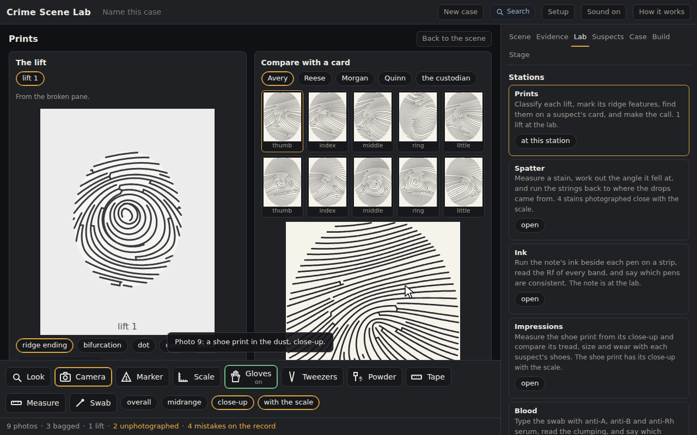
Warm-up
A TV examiner says 'twelve points, it's a match.' Is there a number?
Notes:
Warm-up, minutes 0 to 5. Show the title, essential question and Today I can slides (about 1 minute). Then the warm-up: is there a number of points that makes a match? Take a vote on twelve, eight, sixteen, and write the tally on the board.
No. Let students vote on a number first. The lesson is that examiners weigh quality and quantity, and there is no fixed count.

Slide 5
Words we will use
Delta
The point where ridges from three directions meet, like a river delta. A loop has one; a whorl has at least two; a plain arch has none.
Core
The approximate center of the print.
Ridge ending
A ridge that stops.
Bifurcation
A ridge that forks into two.
Identification, exclusion, inconclusive
The examiner's three calls: the same source, different sources, or not enough to say.
Notes:
Point at each word on the screen the first time the lesson uses it.

Slide 6
Three classes, by the deltas
No delta: an arch
One delta: a loop
Two or more: a whorl
About 65 percent of prints are loops and about 30 percent whorls.
Notes:
Direct instruction (I do), minutes 5 to 12. Show Three classes, by the deltas. Project the app with the starter open, Lab tab, Prints station. On lift 1 count the deltas aloud and press the class chip. Press a ridge ending on the lift: a mark. Pick a suspect, press the right index thumbnail, press the same feature on the big card: a pair, numbered. Show What an examiner does.
It's working when: Pick the wrong suspect first on purpose and show that nothing on the card lines up. The lift is a real finger seen through tape; the wrong finger never fits.

Slide 7
What an examiner does
ACE-V
3
0
analysis, comparison, evaluation, verification
calls: identification, exclusion, inconclusive
fixed number of points that makes a match
A partial, smudged lift may never give enough, and saying so is the right call.

Slide 8
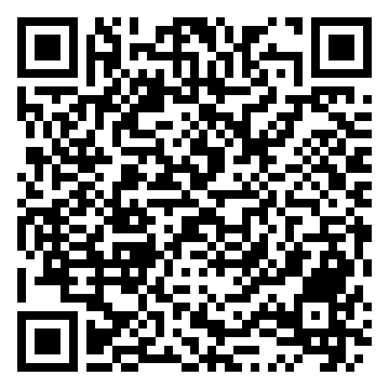
Together: lift 1
1
Open the Lab tab, then the Prints station
2
Count the deltas and name the class
3
Mark three features on the lift
Scan the QR code, or go to
mytekdev.com/try/crimescenelab?lesson=fingerprints-classify-compare-call
4
Pick a suspect and a finger; pair each feature on the card
Notes:
Guided practice (We do), minutes 12 to 22. Have students open the link or scan the QR code. Together: the Lab tab, the Prints station, the deltas of lift 1, its class, three marks on the lift, a suspect and a finger, three pairs. Check that every student's station reads 3 matching features before moving on.
Watch for: Students who mark the card first and then hunt on the lift. Either order pairs, but the lift is the question and the card is the answer sheet.

Slide 9
Lift 2, the smudged one
Rule 1
Rule 2
Rule 3
Classify it if you can, and mark every feature you can find
Compare it with two fingers; pair what matches
Make the call, and write why
Then the rules pane: write the classifier and run it on a card.
Notes:
Independent practice (You do), minutes 22 to 38. Students work lift 2, the smudged one, on their own: classify it if they can, mark what they can find, compare it with two fingers, make the call and write why. Then the rules pane at the bottom of the station: three rules, run on a card. Walk the room with the What to look for questions.
If they ask: "You found two pairs on lift 2 and called it an identification. What would an examiner say to two?" The call

Slide 10
Showcase
Who called the smudged lift inconclusive, and why was that the right answer?
Notes:
Closure, minutes 38 to 45. Show the Showcase slide. Two students explain their call on lift 2. Return to the warm-up tally: the answer to the essential question is that there is no number. Hand out the exit ticket.

Slide 11
Back to our question
How many matching features make a fingerprint match?
Notes:
Ask the essential question again before the exit ticket.

Slide 12
Exit ticket
Answer on your own, on your exit ticket or in your notebook.
1. A print with one delta and a core is:
A. an arch
B. a loop
C. a whorl
2. In the United States, the number of matching points an examiner needs for an identification is:
A. 8
B. 12
C. there is no fixed number
3. Name the three calls an examiner can make, and say which one fits a smudged partial lift with two pairs.
Notes:
Hand out the exit ticket, or have students answer in their notebooks. The answer key is in the plan.

