Slide 1
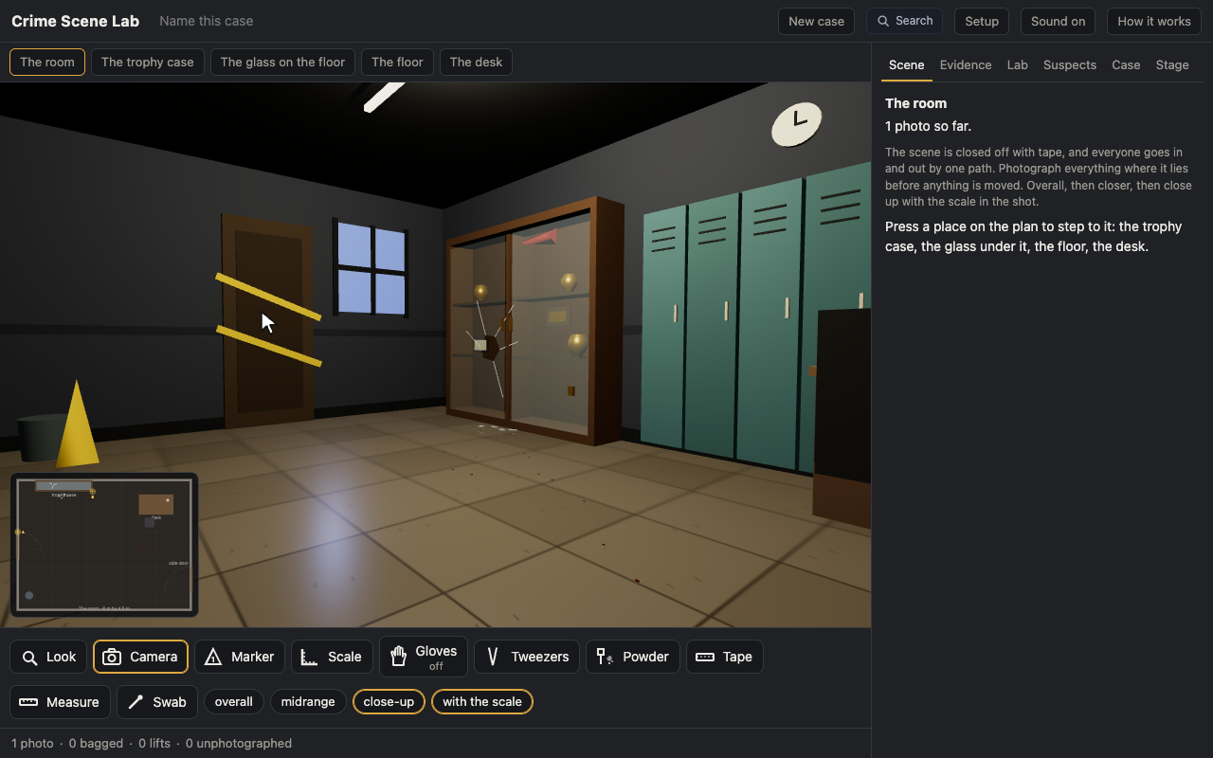
Crime Scene Lab: The Trophy Case, a Crime Scene in One Period
Grades 9-12 · 50 minutes
Slides, rubric and answer key
Print and go
No student accounts
Notes:
Project this as students come in. Students open a virtual crime scene, a broken trophy case with a trail of drops to the door and a note on the desk, and process it the way a forensics class processes a scene: the whole room photographed first in the dark, then each surface closer, then close-ups with the scale; a numbered marker beside each thing before it is picked up; gloves on; wet evidence in paper. They powder the pane, lift a print and send it to the lab. The app keeps the chain of custody and a log of every mistake, and the worksheet asks them to read it back.

Slide 2
Essential question
Why does an investigator photograph everything before touching anything?
Notes:
Read it aloud. Come back to it at the end of the lesson.

Slide 3
Today I can
1
I can process a scene in the right order: photograph overall, midrange and close up with the scale, mark, then collect.
2
I can package evidence correctly: a stain air dried and in paper, never plastic, with gloves on.
3
I can explain what the chain of custody is and read an item's chain from the log.
4
I can say what a mistake at the scene costs, using the app's log line and the evidence chip it leaves.
Notes:
The objectives as I can statements. Read them aloud, and come back to them at the end of the lesson.

Slide 4
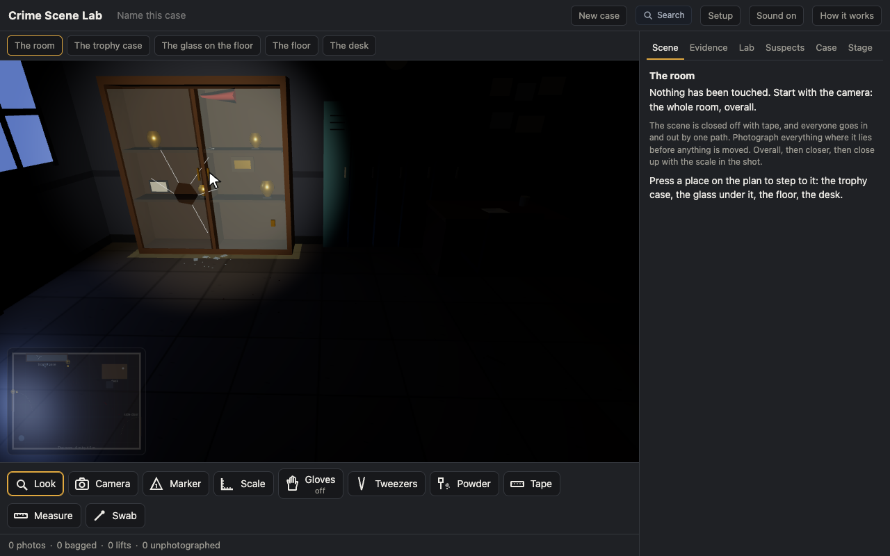
Warm-up
You walk into the room and see a broken trophy case and a shard of glass on the floor. What is the first thing you do?
Notes:
Warm-up, minutes 0 to 6. Show the title, essential question and Today I can slides (about 1 minute). Then the warm-up: project the room, dark, on the board. Ask what the first thing to do is. Take four answers and write them on the board; nobody will say the camera.
Most say pick up the glass. Nobody says take a photo. That is the lesson.

Slide 5
Words we will use
Chain of custody
The paper trail that follows each item from the scene to the lab: who marked it, photographed it, bagged it and sent it, in order.
Latent print
A print left by the oil and sweat of the skin, invisible until powder or a chemical brings it up.
Scale
A ruler laid beside an item in the close-up, so the photo can be measured.
Evidence marker
A numbered tent set beside a thing before it is photographed and picked up.
Lift
A powdered print taken off a surface with tape and pressed onto a card.
Notes:
Point at each word on the screen the first time the lesson uses it.

Slide 6
Document before you touch
The whole room first, overall
Then each surface, midrange
Then close up, with the scale in the shot
The close-up with the scale is the only photo the lab can measure from.
Notes:
Direct instruction (I do), minutes 6 to 14. Show the Document before you touch slide, then The order at a scene. Project the app with the starter open. Pick the camera and press anywhere in the dark room: photo 1, the whole room, and the lights come on. Press the trophy case in the room. Camera, close-up, with the scale: press the pane. Marker: press the pane. Then pick the tweezers and press a shard on the glass view before photographing it: read the log line aloud, no photo in place, and the chip it leaves on the Case tab.
It's working when: The mistake is the point. Make it on purpose on the board so nobody is embarrassed to make it at a desk.

Slide 7
The order at a scene
Rule 1
Rule 2
Rule 3
Photograph it where it lies; a numbered marker beside it
Gloves on; powder a smooth surface; tape the print onto a card
A stain is air dried and goes in paper, never plastic
Every item's chain of custody starts with its photo.

Slide 8
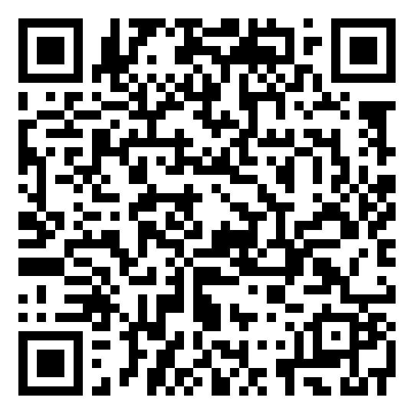
Together: the trophy case
1
Camera: the whole room from the plan
2
Step up to the case; close-up with the scale
3
Marker 1 beside the pane; gloves on
Scan the QR code, or go to
mytekdev.com/try/crimescenelab?lesson=the-trophy-case
4
Powder the pane; tape one print; send the lift
Notes:
Guided practice (We do), minutes 14 to 24. Have students open the link or scan the QR code. Together: the room photo, the case view, the close-up with the scale, marker 1, gloves on, powder, tape one of the prints that came up, and send the lift from the panel on the right. Check that every student's strip reads 1 lift before moving on.
Watch for: Students who powder with the gloves off. Four prints come up instead of three; the fourth is their own. Let the app say it.

Slide 9
The rest of the scene
Rule 1
Rule 2
Rule 3
The glass on the floor: photograph, mark, pick up, paper bag
The floor: close-ups with the scale on four drops
The desk: the note, photographed, picked up, bagged, sent
The strip under the scene counts your mistakes. Read them on the Evidence tab.
Notes:
Independent practice (You do), minutes 24 to 42. Students process the glass on the floor, the floor and the desk on their own: photograph, mark, collect, bag in paper, send. Walk the room with the What to look for questions. Do not correct a student who picks up a shard before the photo; the log will.
If they ask: "Your swab went in a plastic bag. What does the app say will happen to it, and what rule is that?" Why paper?

Slide 10
Showcase
What did the log say you did wrong, and what did the scene lose because of it?
Notes:
Closure, minutes 42 to 50. Show the Showcase slide. Three students read their log line aloud and say what the scene lost. Hand out the exit ticket.

Slide 11
Back to our question
Why does an investigator photograph everything before touching anything?
Notes:
Ask the essential question again before the exit ticket.

Slide 12
Exit ticket
Answer on your own, on your exit ticket or in your notebook.
1. The photo the lab can measure from is:
A. the whole room
B. a midrange shot of the case
C. a close-up with the scale in the shot
2. A shard was picked up before it was photographed. The app says:
A. nothing
B. no photo in place, for good
C. take the photo now and it is fine
3. Name the two things that go beside an item before it is picked up, and say what each one is for.
Notes:
Hand out the exit ticket, or have students answer in their notebooks. The answer key is in the plan.

