Slide 1
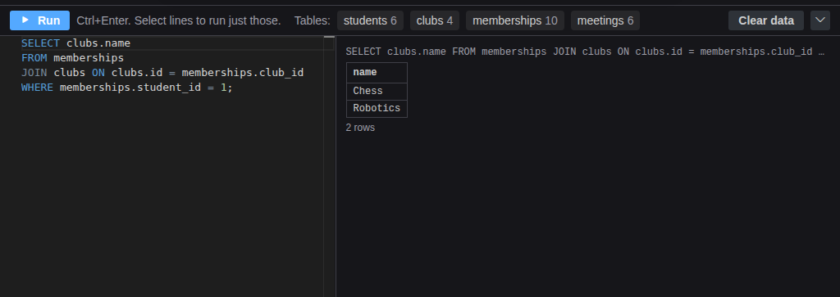
Database Designer: Ask a Database a Question
Grades 7-12 · 45 minutes
Slides, rubric and answer key
Print and go
No student accounts
Notes:
Project this as students come in. Students open the database behind a school's clubs: students, clubs, the memberships that link them, and meetings, already filled with data. They ask it questions in SQL, writing their prediction before every Run: who is in grade 10, which room each club meets in, and which clubs Ana belongs to. The memberships table answers that last one only in numbers, so students decode it by hand, then write a JOIN that does it for them. They finish by adding a membership for a club that does not exist and watching the database refuse it. By the end, students can read a diagram, write a SELECT with WHERE and ORDER BY, and explain what a JOIN and a foreign key are for.

Slide 2
Essential question
How do you ask a database a question, and how does it connect facts stored in different tables?
Notes:
Read it aloud. Come back to it at the end of the lesson.

Slide 3
Today I can
1
I can read a database diagram: tables, columns, primary keys and the lines between tables.
2
I can write SELECT statements with WHERE and ORDER BY, predicting each answer before running it.
3
I can use a JOIN to turn the ids in a linking table into names.
4
I can explain how a foreign key stops data that points at nothing.
Notes:
The objectives as I can statements. Read them aloud, and come back to them at the end of the lesson.

Slide 4
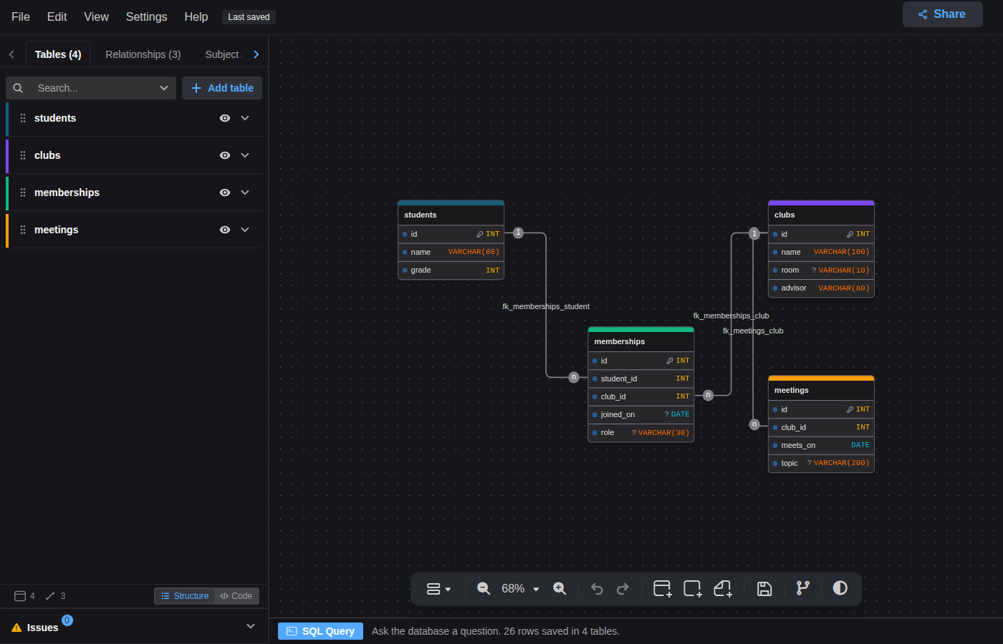
Warm-up
A school keeps its clubs in a database. How would you find out which clubs Ana is in?
Notes:
Warm-up, minutes 0 to 6. Show the title, essential question and Today I can slides (about 1 minute). Then have students open the link or scan the QR code on the worksheet. The app opens on a diagram of four tables: students, clubs, memberships and meetings, with lines between them. A short guide runs along the bottom; tell students to follow it. It has them open the SQL Query bar, press the students button to see its six rows, and change that query to SELECT name FROM students WHERE grade = 9; and run it. Ask: "How would you find out which clubs Ana is in?" Take a few ideas.

Slide 5
Words we will use
database
An organized collection of data that a program can search and change.
table
One kind of thing in a database, like students or clubs. Each row is one of them; each column is one fact about it.
SQL
The language used to ask a database questions and change its data.
query
One question asked in SQL, such as SELECT name FROM students;
primary key
A column whose value is different in every row, usually id, so each row can be found exactly.
foreign key
A column that holds another table's primary key, like club_id in memberships. The database refuses a value that matches no row.
JOIN
Part of a query that matches rows from two tables, for example memberships to clubs by club id.
Notes:
Point at each word on the screen the first time the lesson uses it.

Slide 6
Three words of SQL
Rule 1
Rule 2
Rule 3
SELECT says which columns you want.
FROM says which table to look in.
WHERE says which rows count, and ORDER BY sorts them.
SELECT name FROM students WHERE grade = 9;
Notes:
Direct instruction (I do), minutes 6 to 14. Show the vocabulary and Three words of SQL. On the projector, point to the diagram: each box is a table, each line in it a column, and the key symbol marks the primary key, id. The line from memberships to students says memberships.student_id holds a student's id; the 1 and the n at its ends say one student can have many memberships. In the panel, run SELECT * FROM students; (6 rows), then the guide's SELECT name FROM students WHERE grade = 9; (Ana Lopez and Dev Patel) and ask which part picked those two rows. Change 9 to 10, and before pressing Run, ask the class to predict: Ben Carter and Fatima Noor. Then, predicting first, SELECT name, room FROM clubs ORDER BY name; (Art, Chess, Debate, Robotics). Say: the buttons after Tables: in the bar above the editor are the tables, with how many rows each holds; pressing one replaces what is in the editor with its SELECT and runs it.
It's working when: Ctrl+Enter runs the query too. Several statements separated by semicolons run in order, and each shows its own result.

Slide 7
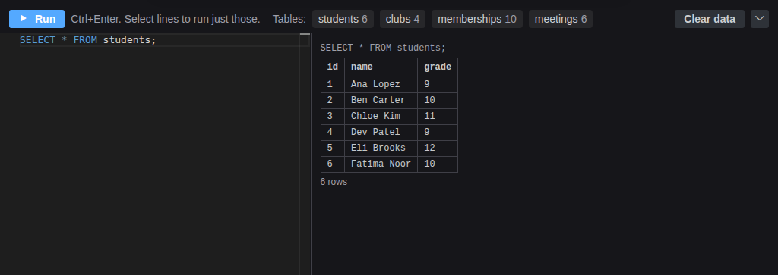
Ask, and read the answer
Each Run shows the query and the rows it returned.

Slide 8

Together: which clubs is Ana in?
1
Find Ana's id in students.
2
Run SELECT * FROM memberships WHERE student_id = 1;
3
Look up each club_id in clubs by hand.
Scan the QR code, or go to
mytekdev.com/try/drawdb?lesson=ask-a-database-a-question
4
Now let a JOIN do the looking up.
Notes:
Guided practice (We do), minutes 14 to 24. Ana's id is 1. Everyone runs SELECT * FROM memberships WHERE student_id = 1; Two rows come back, with club_id 1 and 2. Numbers, not names: ask students to look them up by hand in clubs (1 is Chess, 2 is Robotics). Then show the JOIN: SELECT clubs.name FROM memberships JOIN clubs ON clubs.id = memberships.club_id WHERE memberships.student_id = 1; It returns Chess and Robotics. Read it aloud: take each membership, find the club whose id matches its club_id, and show that club's name. This is why memberships exists: a student can be in many clubs and a club has many students, so neither table can hold the list, and the linking table holds one row per pairing.
Watch for: Names must match the diagram exactly: memberships, club_id. A misspelled name gives no such table or no such column, with a hint under it.

Slide 9
The JOIN
JOIN matches each membership to its club, so the answer comes back as names.

Slide 10
Your questions
Rule 1
Rule 2
Rule 3
Predict each answer on the worksheet, then run it.
Write a JOIN that finds everyone in Robotics.
Add Dev to club 7. Read the error, then fix it.
Rows you add are saved with the project.
Notes:
Independent practice (You do), minutes 24 to 38. Students work through the worksheet's prediction table, writing each answer before running it: Robotics' meetings in date order, and a JOIN of their own that lists everyone in Robotics (Ana Lopez, Ben Carter and Fatima Noor). Then: INSERT INTO memberships (student_id, club_id, role) VALUES (4, 7, 'member'); The answer is Statement 1: FOREIGN KEY constraint failed, because there is no club 7. Students fix it with club 3, run it, and check Dev's clubs with a JOIN: Chess and Art. Walk the room and ask the questions under What to look for.
Watch for: A join of students and clubs returns two columns both called name. Writing students.name AS student, clubs.name AS club gives them different headings.
Watch for: Rows added with INSERT stay with the project. If a student's data gets confusing, Clear data empties every table, and opening the lesson link in a new tab starts over with the original rows. Reloading the same tab keeps the changes.

Slide 11
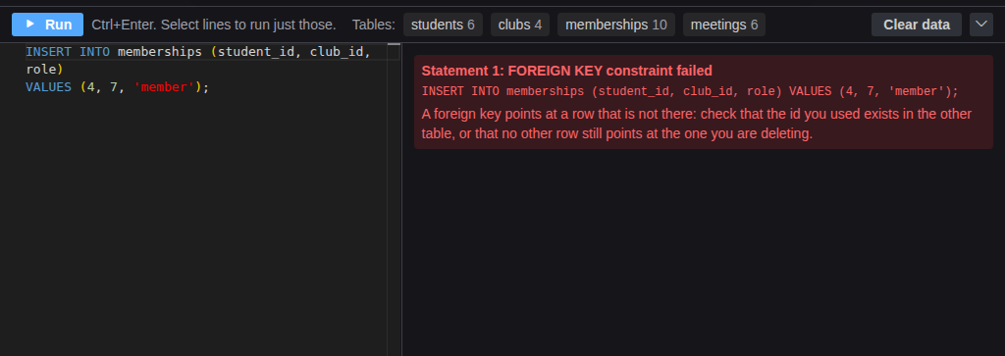
Explain it
The database refused Dev's membership in club 7. Why is that a good thing?
Notes:
Closure, minutes 38 to 45. Show the last slide and ask: "The database refused Dev's membership in club 7. Why is that a good thing?" (A membership in a club that does not exist would be data that points at nothing; the foreign key, the line in the diagram, makes the database refuse it.) Ask the essential question again, then hand out the exit ticket.

Slide 12
Back to our question
How do you ask a database a question, and how does it connect facts stored in different tables?
Notes:
Ask the essential question again before the exit ticket.

Slide 13
Exit ticket
Answer on your own, on your exit ticket or in your notebook.
1. In SELECT name FROM students WHERE grade = 9; which part picks the rows?
A. SELECT name
B. FROM students
C. WHERE grade = 9
2. Why does the memberships table hold student_id and club_id instead of names?
A. numbers are smaller
B. one person can be in many clubs and a club has many members, so the pairings get their own table
C. names are not allowed in databases
3. A new row in memberships says club_id 12, and there is no club 12. What does the database do, and why is that useful?
Notes:
Hand out the exit ticket, or have students answer in their notebooks. The answer key is in the plan.

