Slide 1
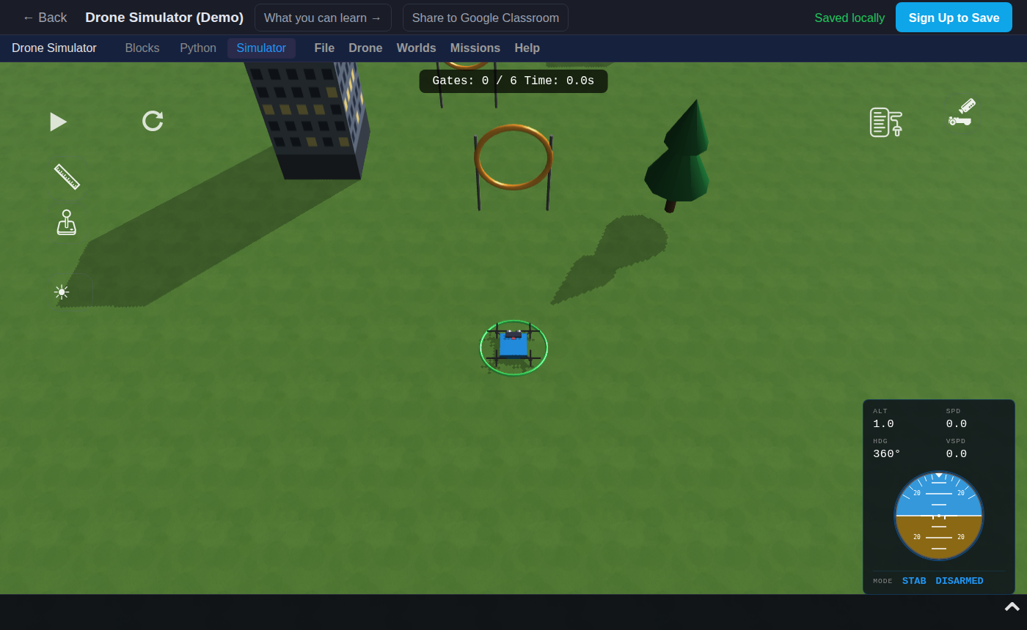
Drone Simulator: Program a Drone Through the Rings
Grades 4-8 · 45 minutes
Slides, rubric and answer key
Print and go
No student accounts
Notes:
Project this as students come in. Students run a block program that flies a drone through six rings and lands. They find out that each fly to block is a place in the sky, three numbers for left and right, forward and height, and that the drone goes exactly where those numbers say. By the end, they can change one number, say beforehand which ring will stay orange, and fix a classmate's broken program by reading it.

Slide 2
Essential question
How does a program tell a drone where to fly?
Notes:
Read it aloud. Come back to it at the end of the lesson.

Slide 3
Today I can
1
I can explain what the three numbers in a fly to block mean: left and right, forward, and height.
2
I can predict which ring a changed number will make the drone miss, then test the prediction.
3
I can find the block that makes a drone miss a ring by reading the program, and fix it.
4
I can change a program on purpose so the drone skips a ring, without deleting any blocks.
Notes:
The objectives as I can statements. Read them aloud, and come back to them at the end of the lesson.

Slide 4
Warm-up
How does the drone know where each ring is?
Notes:
Warm-up, minutes 0 to 7. Show the title, essential question and Today I can slides (about 1 minute). Then have students open the link or scan the QR code on the worksheet. The app opens on the Simulator with the course of six orange rings. A short guide runs along the bottom: tell students to do its first step only, which is to press Run (the play button) and watch, then wait. Each ring turns green as the drone flies through it, and the drone lands at the end. Ask: "How does the drone know where each ring is?"

Slide 5
Words we will use
program
A list of steps for a computer to follow, in order.
block
One step of a program. Blocks snap together, and the program runs them from top to bottom.
sequence
The order the steps run in. Change the order, and the drone does something different.
coordinates
Numbers that say where something is. Here there are three: left and right, forward, and height.
altitude
How high the drone is. The fly to block calls it alt.
predict
Say what you think will happen before you test it.
bug
A mistake in a program that makes it do something you did not want.
Notes:
Point at each word on the screen the first time the lesson uses it.

Slide 6
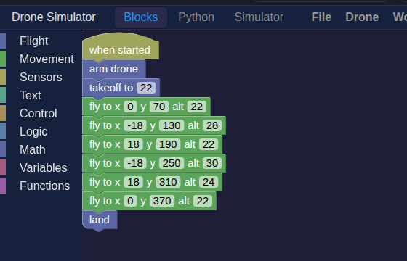
The program that flies it
The drone runs the blocks in sequence, top to bottom: arm, takeoff, six fly to blocks, land.
Notes:
Direct instruction (I do), minutes 7 to 15. Show the vocabulary slide. Then, on the projector, open Blocks. Read the program from top to bottom: arm, takeoff to 22, six fly to blocks, land. Say: this is a sequence, steps that run in order. Point to the first fly to block: x 0, y 70, alt 22. Say: these are three coordinates. x is left and right, y is forward, and alt is the altitude, the height. The first ring is 60 forward and 22 high, and the block aims at 70 so the drone flies through the ring and out the other side. Show the Before every Run slide: Run starts from wherever the drone is, so press reset, the circle arrow next to Run, first. Then change the first block's x from 0 to 30, ask the class to predict which ring will stay orange, press reset and Run. Ring 1 stays orange and the other five turn green.
It's working when: With ring 1 missed, the counter at the top of the 3D view stops at `Gates: 5 / 6` instead of `Course Complete!`.

Slide 7
Three numbers make a place in the sky
x
y
alt
left and right
forward
height
Each fly to block aims just past one ring, so the drone flies through it.

Slide 8
Before every Run
Rule 1
Rule 2
Rule 3
Press reset, the circle arrow, so the drone starts over.
Say which ring will stay orange.
Then press Run and watch.
Run starts from wherever the drone is now. Reset puts it back at the start.

Slide 9
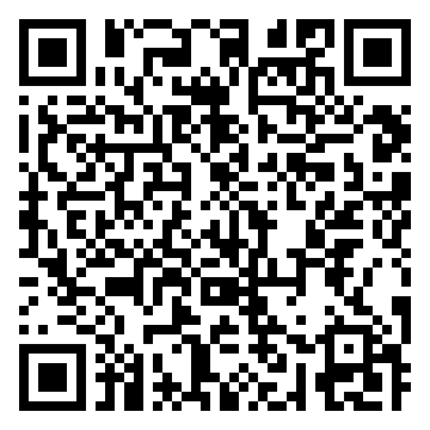
Together: predict, then test
1
Open Blocks. Find the third fly to block.
2
Change its x from 18 to -18.
3
Write which ring you think will stay orange.
Scan the QR code, or go to
mytekdev.com/try/dronesimulator?lesson=program-a-drone-through-the-rings
4
Press reset, then Run. Were you right?
Notes:
Guided practice (We do), minutes 15 to 23. Everyone sets the first block's x back to 0. Then together: find the third fly to block (x 18, y 190, alt 22) and change its x to -18. Before anyone presses Run, students write in the table which ring they think will stay orange. Then reset and Run. Ring 3 stays orange, because the drone now flies to the other side of it; the rings before and after still turn green. Set it back to 18. Before moving on, check that every table has a prediction and a result for this row.
Watch for: Students change the number and look for Run in Blocks. Run and reset are on the Simulator tab only. If the drone flies back down the course, it was not reset first.

Slide 10
Two challenges
Rule 1
Rule 2
Make the drone skip ring 4 without deleting a block.
Put a bug in: change one number in secret. Your partner predicts the orange ring, then fixes it.
Write every prediction before you press Run.
Notes:
Independent practice (You do), minutes 23 to 37. Walk the room and ask the questions under What to look for. Challenge 1: make the drone skip ring 4 without deleting any blocks (raising the fourth fly to block's alt from 30 to 60 flies it over the ring; other changes work too). Challenge 2, in pairs: one student changes one number in one fly to block while the other looks away, and writes it down. This is a bug on purpose. The partner reads the blocks, predicts which ring will stay orange, then presses reset and Run, fixes the number and runs it again. Swap roles. Repeat the rule: every prediction is written before Run.
Watch for: A partner who hides the change by typing in the Python tab gets a warning dialog, and from then on Run ignores the blocks, so fixing the block changes nothing. Keep the secret change in Blocks.

Slide 11
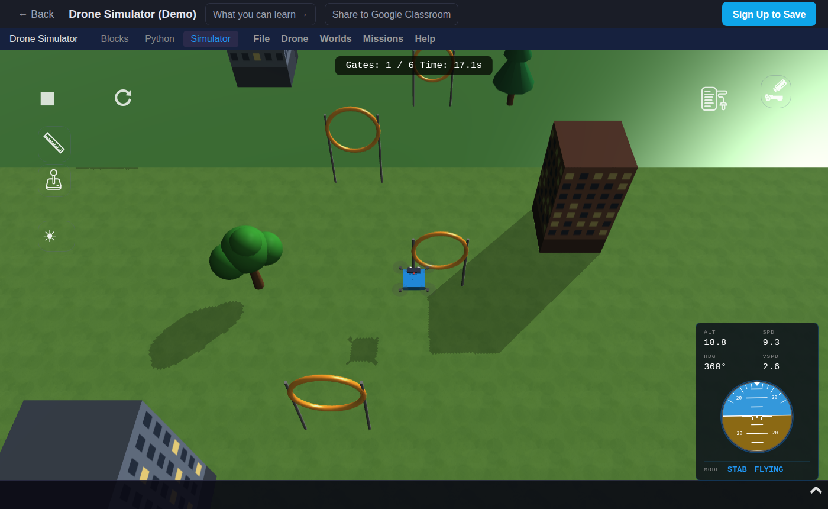
Read the program
Ring 2 stays orange. Which block would you check first, and why?
Notes:
Closure, minutes 37 to 45. Show the last slide and ask: "Ring 2 stays orange. Which block would you check first, and why?" (The second fly to block, because each block aims at one ring.) Ask the essential question again, then hand out the exit ticket.

Slide 12
Back to our question
How does a program tell a drone where to fly?
Notes:
Ask the essential question again before the exit ticket.

Slide 13
Exit ticket
Answer on your own, on your exit ticket or in your notebook.
1. In the block fly to x 0 y 70 alt 22, what does 22 tell the drone?
A. how far forward to go
B. how high to fly
C. how fast to fly
2. You change the x of the fifth fly to block and press reset and Run. What is most likely to happen?
A. the drone misses ring 5 and passes the others
B. the drone misses every ring
C. nothing changes
3. Ring 2 stays orange in a classmate's program. Which block would you check first, and what would you look for?
Notes:
Hand out the exit ticket, or have students answer in their notebooks. The answer key is in the plan.

