Slide 1
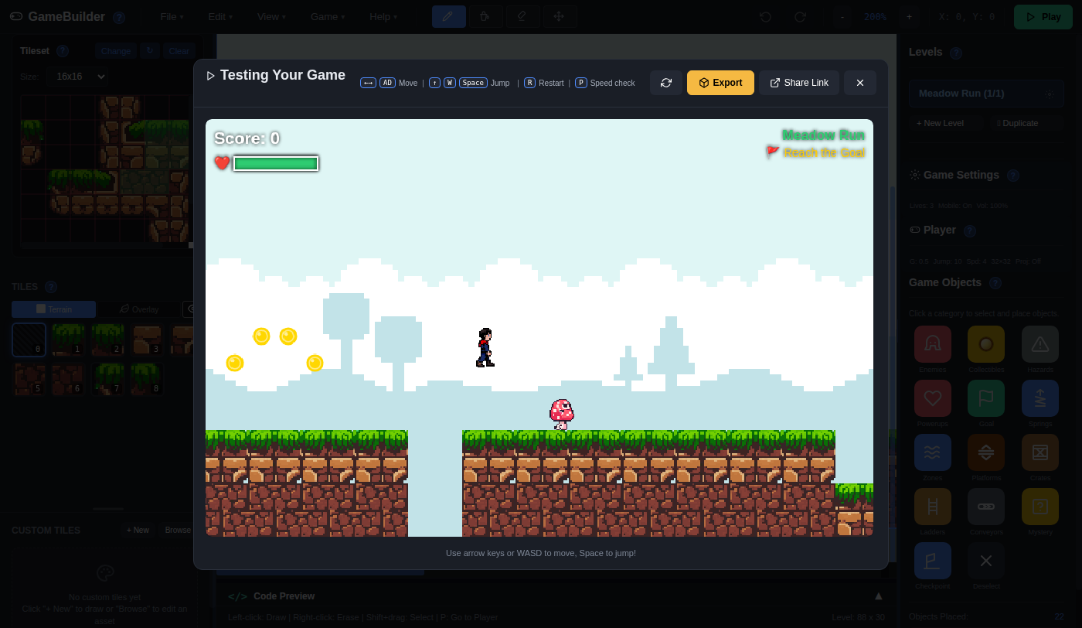
Game Builder: Change the Rules with Variables
Grades 4-8 · 45 minutes
Slides, rubric and answer key
Print and go
No student accounts
Notes:
Project this as students come in. Students play Meadow Run, a finished platform game, then change three numbers the game reads: Gravity, Jump Power and Move Speed. One small change traps the player in a valley, and that is the moment a variable makes sense: one number, used everywhere. By the end, each student has a game with rules of their own that still works, and a classmate who has to guess what they changed.

Slide 2
Essential question
How can changing one number change a whole game?
Notes:
Read it aloud. Come back to it at the end of the lesson.

Slide 3
Today I can
1
I can explain that a variable is a named number the game reads, and that changing it changes everything that uses it.
2
I can predict what a change to Gravity or Jump Power will do, then test the prediction and record what happened.
3
I can find and fix a part of a level that a new value has made impossible.
4
I can change at least two variables to give a game new rules that a player can still beat.
Notes:
The objectives as I can statements. Read them aloud, and come back to them at the end of the lesson.

Slide 4
Warm-up
What one thing would make this game feel different?
Notes:
Warm-up, minutes 0 to 7. Show the title, essential question and Today I can slides (about 1 minute). Then have students open the link or scan the QR code on the worksheet. A short guide runs along the bottom of the app: tell students to do its first step only, which is to press Play and run to the star, then press Esc and wait. The arrow keys run, Space jumps, R starts the level over and Esc goes back to the editor. Ask: "What one thing would make this game feel different?"

Slide 5
Words we will use
variable
A name for a number the game keeps and reads. Change the number and everything that uses it changes.
value
The number a variable holds right now, like 10 for Jump Power.
gravity
How fast the player is pulled down. A bigger number pulls harder.
jump power
How fast the player starts moving up when it jumps. A bigger number jumps higher.
predict
Say what you think will happen before you test it.
bug
A part of a program that does not work the way it should.
Code Preview
The panel at the bottom of Game Builder that shows the code behind a setting, with your numbers in it.
Notes:
Point at each word on the screen the first time the lesson uses it.

Slide 6
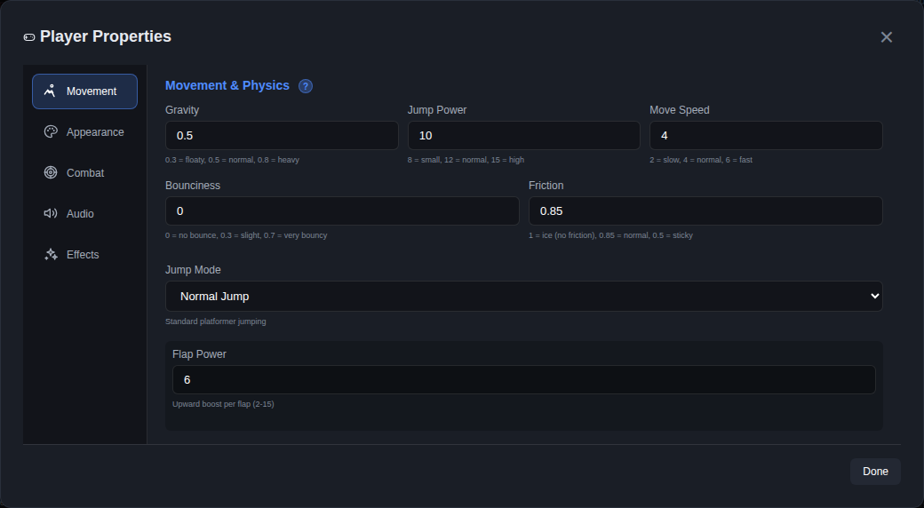
Three numbers run the player
Gravity: 0.5
Jump Power: 10
Move Speed: 4
Each one is a variable. The game reads it every time the player moves.
Notes:
Direct instruction (I do), minutes 7 to 15. Show the vocabulary slide. Then, on the projector, click Player on the right. The Movement tab shows Gravity 0.5, Jump Power 10 and Move Speed 4. Say: each one is a variable, a named number the game reads every time the player moves. Ask the class to predict what Jump Power 8 will do. Set it to 8, press Done and press Play. Run right: the player drops into the low valley with the mushroom and cannot jump back out, because its walls are 2 tiles tall and a jump of 8 now climbs less than 2. Press R to start over, then Esc. Say: the level did not change, only one number did, and that is a bug we made on purpose. Set Jump Power back to 10 and press Done. Then click the Code Preview bar under the level to open it, and click Game Settings on the right: the code shows player.velocityY = -10 next to jump power and += 0.5 next to gravity. Those are the same numbers. Press Done.

Slide 7
One number broke the game
10
8
Jump Power: the player climbs out of the valley
Jump Power: the player is stuck in the valley
The level did not change. Only one number did.

Slide 8
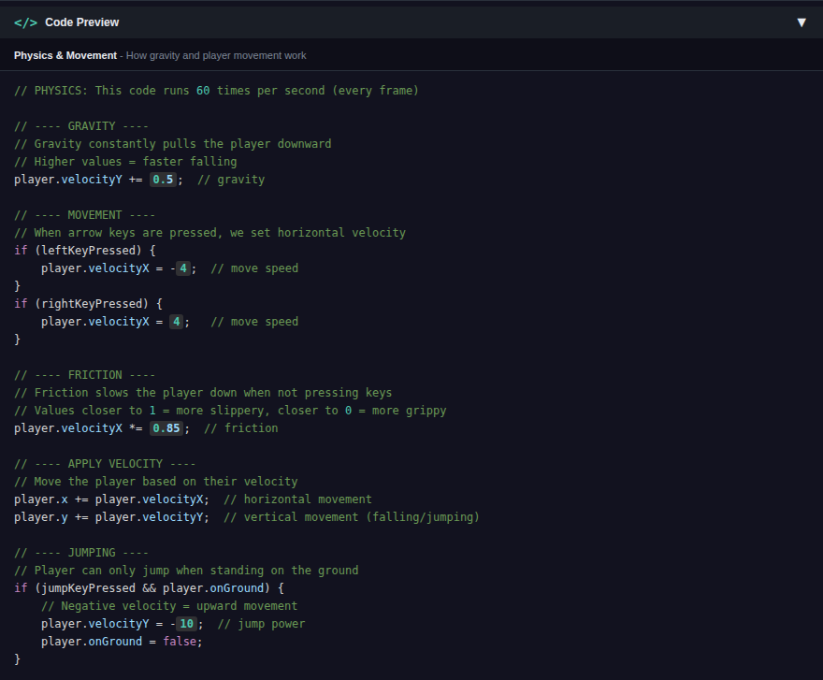
The same number in the code
Click Game Settings to see your numbers in the code. Change a number, and the code reads the new one.

Slide 9
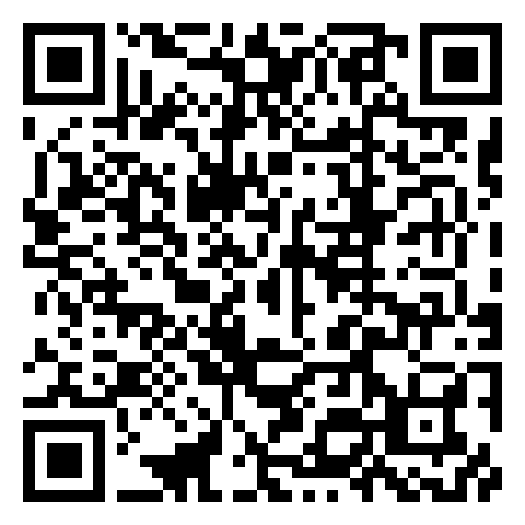
Together: predict, then test
1
Write your prediction for Gravity 0.8.
2
Click Player, set Gravity to 0.8, press Done.
3
Press Play. Write what happened.
Scan the QR code, or go to
mytekdev.com/try/gamemaker?lesson=change-the-rules-with-variables
4
Do the same for Gravity 0.3.
Notes:
Guided practice (We do), minutes 15 to 23. Students write a prediction for Gravity 0.8 in the table on the worksheet before anyone touches the app. Then together: click Player, set Gravity to 0.8, press Done, press Play, and run to the valley. Gravity 0.8 traps the player too: it pulls harder, so the jump is lower. Students write what happened. Repeat with Gravity 0.3: the player floats and jumps much higher. Before moving on, check that every table has a prediction and a result for both rows, and that everyone has set Gravity back to 0.5.

Slide 10
Make it yours
Rule 1
Rule 2
Rule 3
Change at least two numbers, one at a time.
Press Play after every change.
A player must still be able to reach the star.
If a change breaks a part, fix the number or fix the level.
Notes:
Independent practice (You do), minutes 23 to 37. Walk the room and ask the questions under What to look for. Repeat the three rules: change at least two numbers, one at a time; press Play after every change; a player must still be able to reach the star. A student whose change breaks a part fixes it either way: change the number back a little, or change the level. To change the level, pick a tile under Tiles on the left and click on the level to draw it (right-click erases), for example a step in the valley wall.

Slide 11
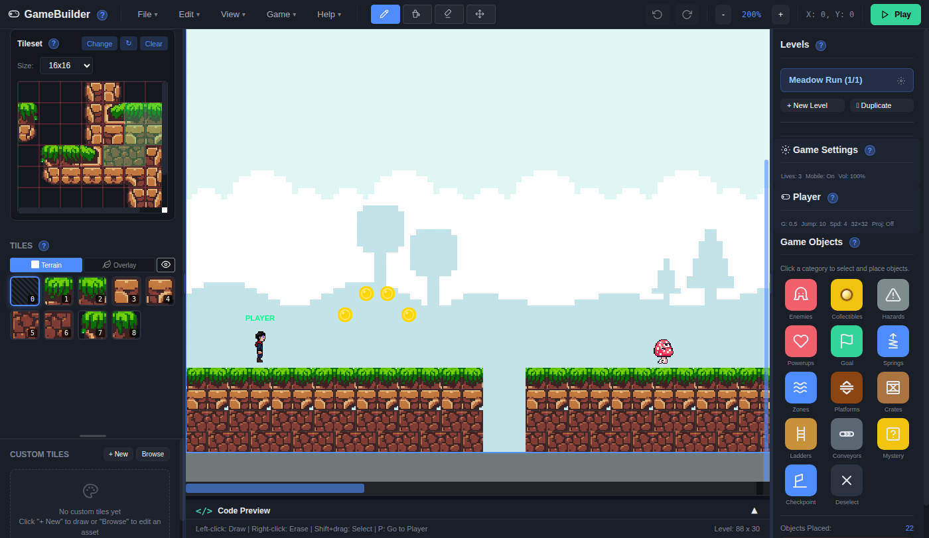
Swap and guess
Which numbers did your classmate change? Higher or lower?
Notes:
Closure, minutes 37 to 45. Each builder presses Play before the swap, because the Player box on the right shows the numbers. Students trade seats and play a classmate's game for about 3 minutes, staying in the game (no Esc). They write which numbers they think were changed, and whether each went up or down. The builder then says what was really changed. Ask the essential question again, then hand out the exit ticket.

Slide 12
Back to our question
How can changing one number change a whole game?
Notes:
Ask the essential question again before the exit ticket.

Slide 13
Exit ticket
Answer on your own, on your exit ticket or in your notebook.
1. With Jump Power 8 the player is stuck in the valley. What changed?
A. the level
B. the value of a variable the game reads
C. the player's picture
2. Gravity goes from 0.5 to 0.8. The jump gets:
A. higher
B. lower
C. the same
3. In a classmate's game, the player cannot climb a wall. Name two different ways to fix it.
Notes:
Hand out the exit ticket, or have students answer in their notebooks. The answer key is in the plan.

