Slide 1
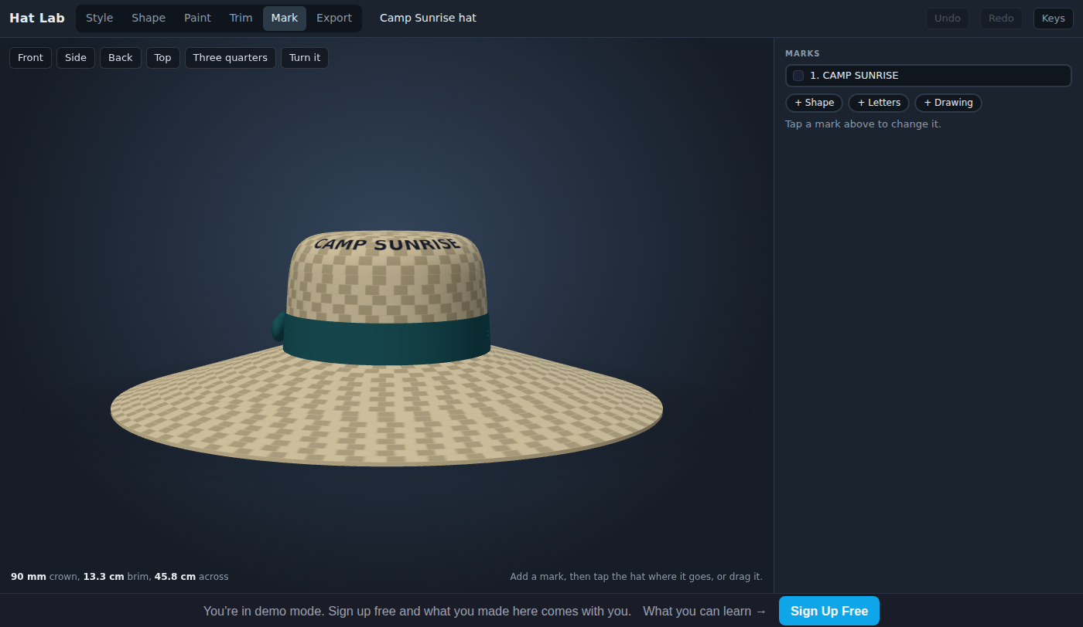
Hat Lab: Design a Sun Hat to a Client's Brief
Grades 4-8 · 45 minutes
Slides, rubric and answer key
Print and go
No student accounts
Notes:
Project this as students come in. A summer camp sends back the ball cap it ordered: the counselors' necks and ears burn by lunch. Students read the camp's brief, four requirements with numbers in them, and find that the cap can never pass, because its bill only shades the front. They design a hat in Hat Lab that fits a 56 cm head, has a brim of at least 76 mm (3 inches) all the way around, stays under 12 cm tall and carries the camp's name, check each requirement against the measurements under the hat, and hand it to a classmate who signs off the brief.

Slide 2
Essential question
How do designers know when a design is done?
Notes:
Read it aloud. Come back to it at the end of the lesson.

Slide 3
Today I can
1
I can explain the difference between a requirement a design must meet and a choice the designer is free to make.
2
I can read the app's measurements and decide whether each requirement in a brief is met.
3
I can change a design one step at a time until it meets every requirement in the brief.
4
I can check a classmate's design against the brief and say which requirement it misses, if any.
Notes:
The objectives as I can statements. Read them aloud, and come back to them at the end of the lesson.

Slide 4
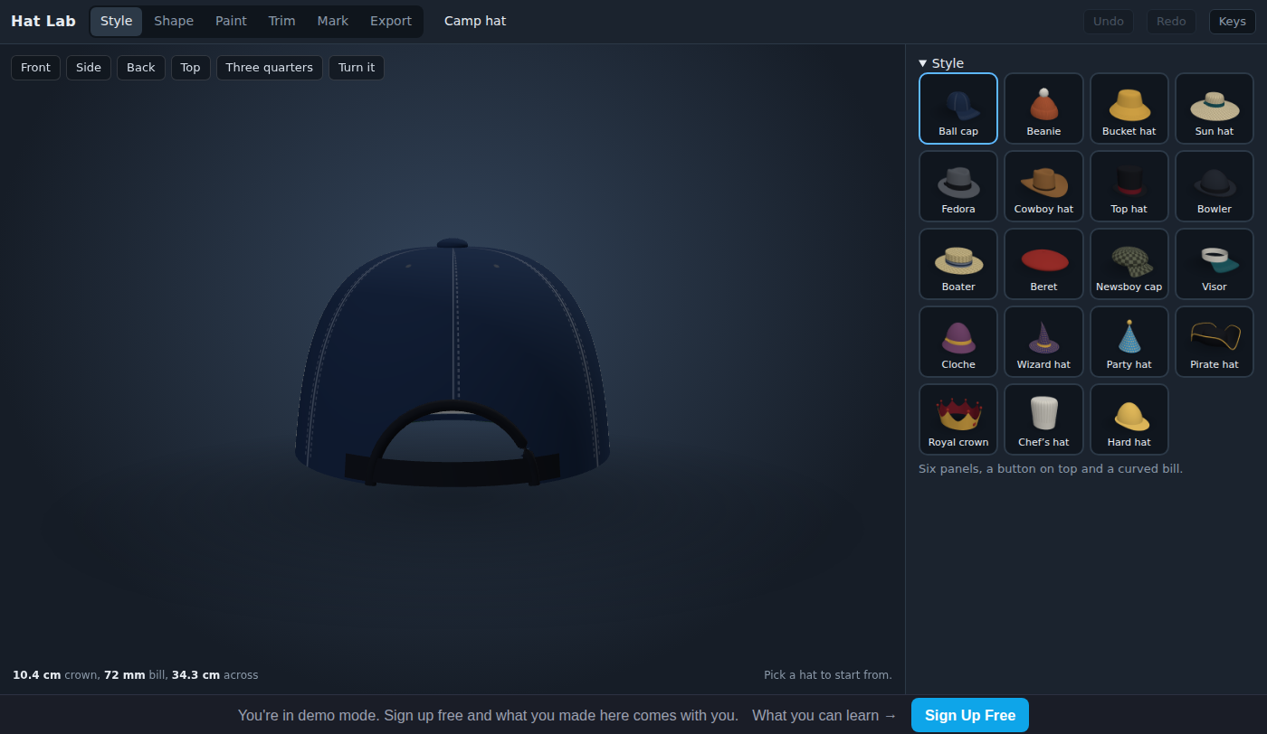
Warm-up
The counselors' necks burn by lunch. Why?
Notes:
Warm-up, minutes 0 to 7. Show the title, essential question and Today I can slides (about 1 minute). Then have students open the link or scan the QR code on the worksheet: Hat Lab opens on the camp's ball cap. A short guide runs along the bottom; tell students to do its first step only, which is to press Back above the hat and look at the cap from behind, then wait. Read the camp's note on the worksheet aloud: the counselors' necks and ears burn by lunch. Ask: "Why?" (The bill shades only the front of the face.)

Slide 5
Words we will use
client
The person or group a design is made for.
brief
The client's list of what the design must do, written before the design starts.
requirement
One thing the brief says the design must do. You can check it with a yes or no.
constraint
A limit the design must stay inside, like a hat no taller than 12 cm.
brim
The part of a hat that sticks out from the bottom edge and makes shade.
crown
The part of a hat that covers the top of the head.
circumference
The distance all the way around something, like around a head just above the ears.
Notes:
Point at each word on the screen the first time the lesson uses it.

Slide 6
Camp Sunrise's brief
1
Fit a head with a 56 cm circumference.
2
Give it a brim of 76 mm or more, all the way around.
3
Keep it no taller than 12 cm: a constraint.
4
Put CAMP SUNRISE on the front.
Notes:
Direct instruction (I do), minutes 7 to 15. Show the vocabulary slide, then the brief slide. Read the four requirements and point out that each one has a number you can check. Say: a limit like the height is a constraint, and the brief does not say the color or the style; those are the designer's choices. Show the Why 76 mm slide, and point out that the app says mm up to 99 mm, then cm: 13.3 cm is 133 mm. Then, on the projector, open Shape: the Size section shows the head the hat fits (US 7 1/8 is 57 cm around), the sliders say each part's size, and the line under the hat says the crown, the brim or bill, and the width. Point out that a ball cap's number says bill, and a bill is not all the way around, so the cap can never meet the brief, however long the bill.

Slide 7
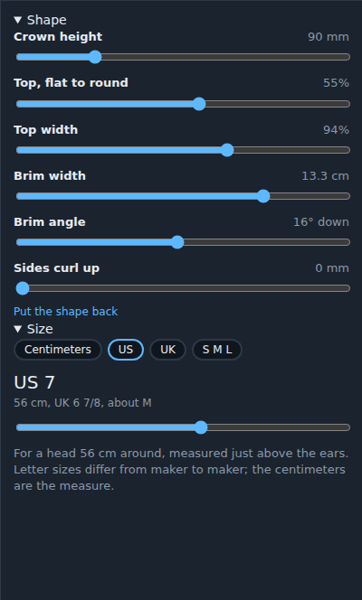
The hat measures itself
The numbers under the hat and on the sliders are the hat's real size. Check every requirement there.

Slide 8
Why 76 mm?
3 inches
the brim the Skin Cancer Foundation recommends, all the way around: 76 mm
A brim shades the face, ears and neck. A bill shades only the front.

Slide 9
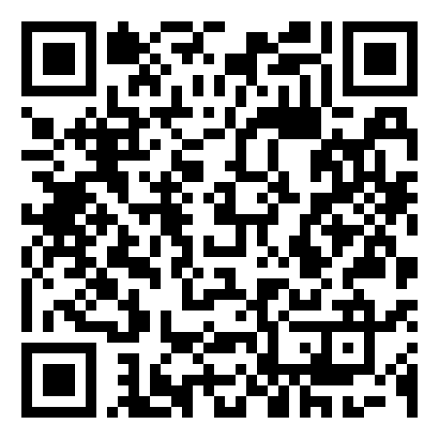
Together: a hat that fits
1
Open Style. Pick a hat with a brim all the way around.
2
Open Shape. Slide the size to 56 cm.
3
Read Brim width. Is it 76 mm or more?
Scan the QR code, or go to
mytekdev.com/try/hatlab?lesson=design-a-sun-hat-to-a-brief
4
Write each number on the brief.
Notes:
Guided practice (We do), minutes 15 to 23. Together: open Style and pick the Bucket hat, which has a brim all the way around. Open Shape and slide the size to 56 cm (US 7). Read Brim width: about 54 mm, not enough. Drag Brim width until it reads 76 mm or more. Say: setting the size first matters, because the whole hat grows and shrinks with the head, and every number changes with it. Before moving on, check that every student has a hat at 56 cm with a brim that reads 76 mm or more.
Watch for: A student who widened the brim before setting the size: the starter is 57 cm, so a brim set to 76 mm there reads 75 mm at 56 cm. Set the size, then read the brim again.

Slide 10
Meet the brief
Rule 1
Rule 2
Rule 3
Check all four requirements, one at a time.
Set the size first: it changes every other number.
Then make it yours: colors, pattern, trim.
A requirement is met only when the number says so.
Notes:
Independent practice (You do), minutes 23 to 37. Walk the room and ask the questions under What to look for. Students may keep the bucket hat or pick another style: any hat with a brim all the way around can pass if they change it to fit, but a few will fail the height limit (the cowboy hat's crown is 12.6 cm at this size, and Crown height must be dragged lower on Shape). Students put the camp's name on the front in Mark: press + Letters, type the name (up to 12 letters, spaces count: CAMP SUNRISE fits), then tap the front of the hat. Then they choose colors in Paint and trims in Trim. Repeat the rules: a requirement is met only when the number says so, and set the size first.
Watch for: Switching style puts every Shape slider back to the new style's start, so a widened brim or lowered crown is lost; the size and the name stay. After any style change, read every number again.
Watch for: A new Letters mark says ABC. The camp's name goes in the Letters box, not in the hat's name at the top.

Slide 11
Sign it off
Does your classmate's hat meet all four requirements? How do you know?
Notes:
Closure, minutes 37 to 45. Students trade seats. Each one checks a classmate's hat against the brief by reading the numbers in the app, ticks each requirement that is met, and signs the bottom of the classmate's worksheet, or writes which requirement is missed. Ask the essential question again, then hand out the exit ticket.
Watch for: A checker who drags a slider changes the classmate's numbers. `Undo` at the top right puts it back.

Slide 12
Back to our question
How do designers know when a design is done?
Notes:
Ask the essential question again before the exit ticket.

Slide 13
Exit ticket
Answer on your own, on your exit ticket or in your notebook.
1. Which hat can never meet a brief that asks for a brim all the way around?
A. a bucket hat
B. a ball cap
C. a sun hat
2. The brief asks for a brim of at least 76 mm. The app says Brim width 68 mm. The hat:
A. meets it
B. misses it: widen the brim
C. misses it: make the crown shorter
3. You change the size from 56 cm to 60 cm, and the brim number gets bigger. Why?
Notes:
Hand out the exit ticket, or have students answer in their notebooks. The answer key is in the plan.

