Slide 1
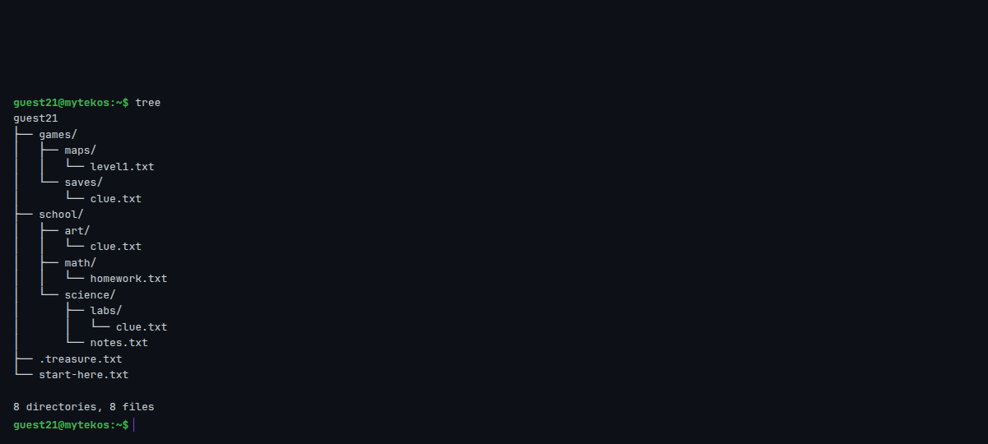
Linux Terminal: Where Am I? A Folder Treasure Hunt
Grades 6-12 · 45 minutes
Slides, rubric and answer key
Print and go
No student accounts
Notes:
Project this as students come in. The worksheet's link opens a terminal with a treasure hunt already laid out in its folders. Each clue file says where the next one is and exactly how to get there: a path down through three folders, then up two with .., then a full path from the very top, and finally home with ~ to a hidden file that a plain ls does not show. Along the way students learn the one question a command line keeps asking, where am I, and the commands that answer it. They finish by installing a tool that draws the whole map of where they have been.

Slide 2
Essential question
How does a computer know where a file is?
Notes:
Read it aloud. Come back to it at the end of the lesson.

Slide 3
Today I can
1
I can say where they are in a folder tree with pwd, and list what is there with ls.
2
I can move through folders with cd, using a relative path, .. and ~.
3
I can explain the difference between a relative path and an absolute path, and use each.
4
I can find hidden files with ls -a.
Notes:
The objectives as I can statements. Read them aloud, and come back to them at the end of the lesson.

Slide 4
Warm-up
Your computer has thousands of files. When you double-click a folder, how does the computer know which one you mean?
Notes:
Warm-up, minutes 0 to 6. Show the title, essential question and Today I can slides (about 1 minute). Ask: "Your computer has thousands of files. When you double-click a folder, how does the computer know which one you mean?" Take a few answers. Then students open the link or scan the QR code on the worksheet. A terminal opens and prints Lesson ready: Where Am I?. The hunt is already set up in their folders.

Slide 5
Words we will use
terminal
A window where you type commands to a computer instead of clicking.
folder (directory)
A container for files and other folders. Folders inside folders make a tree.
path
Directions to a file or folder, with the names separated by /.
relative path
Directions from where you are now, like school/art.
absolute path
Directions from the very top, starting with /, like /home/guest10/games. They work from anywhere.
home (~)
Your own folder. cd ~ (or just cd) always takes you there.
hidden file
A file whose name starts with a dot. ls skips it; ls -a shows it.
Notes:
Point at each word on the screen the first time the lesson uses it.

Slide 6

The hunt begins
The link sets up the hunt. cat prints a file; the first clue says where to go and what to type.
Notes:
Direct instruction (I do), minutes 6 to 14. On the projector, type pwd: it prints the folder you are in, a path like /home/guest10, which is your home folder (yours will have its own number). Type ls: it lists what is in this folder, folders with a / after their name. Explain the tree: folders inside folders, and a path is the directions down the tree, names separated by /. Then type cat start-here.txt and read it together. Show the three moves: cd folder goes down into a folder, cd .. goes up one, cd ~ (or just cd) goes home from anywhere. Point out that typing a command and pressing Enter is all there is: the terminal answers, or says nothing when it worked.
It's working when: pwd prints /home/ and a guest name ending in a number. Every student's number is different, and that is fine.

Slide 7
Three questions, three commands
Rule 1
Rule 2
Rule 3
Where am I? pwd
What is here? ls
Go somewhere. cd folder
.. means up one folder. ~ means home. A path starting with / starts from the very top.

Slide 8
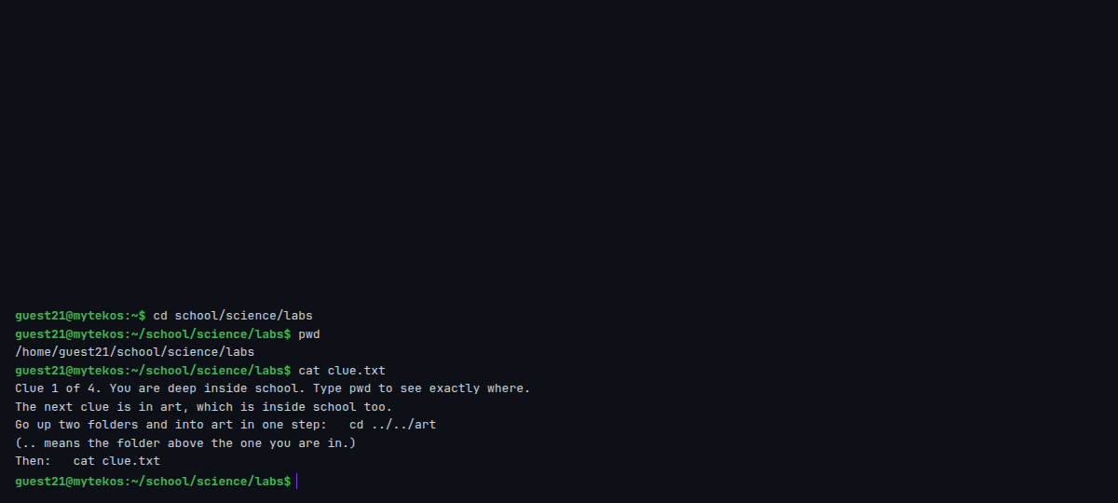
Clue 1: a relative path
cd school/science/labs goes down three folders from where you are. pwd shows the full path.
Notes:
Guided practice (We do), minutes 14 to 22. Together, students follow the first clue: cd school/science/labs (a relative path, three folders down from home), pwd, then cat clue.txt. They write the pwd on the worksheet. Clue 1 says to go up two folders and into art in one step: cd ../../art. Ask why two .. and not one: labs is inside science, which is inside school, so up twice reaches school. pwd again, and cat clue.txt for clue 2.
Watch for: No such file or directory after a cd means a typo or a missing slash. ls shows the folder names exactly as they are spelled.
If they ask: "Why cd ../../art and not cd art?" art is not inside labs. Each .. goes up one folder: labs to science, science to school, and school has art in it.

Slide 9

Together: the first two clues
1
cat start-here.txt
2
cd school/science/labs, then cat clue.txt
3
cd ../../art, then cat clue.txt
Scan the QR code, or go to
mytekdev.com/try/terminal?lesson=where-am-i
4
Write pwd at every stop.

Slide 10
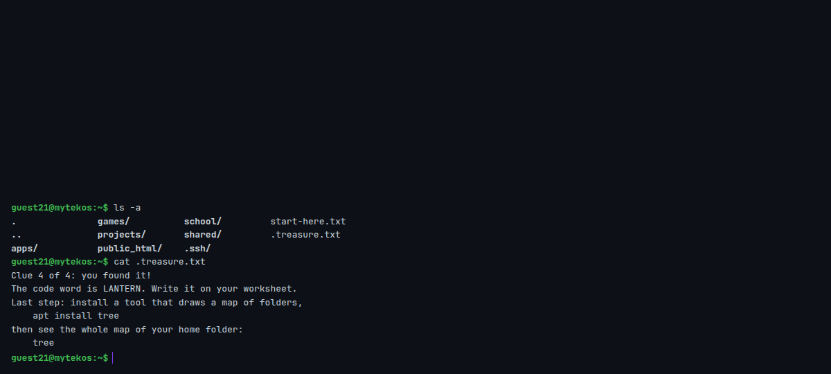
The hidden treasure
ls -a shows files whose names start with a dot. The code word is in .treasure.txt.
Notes:
Independent practice (You do), minutes 22 to 36. Clue 2 asks for an absolute path: the whole path from the top, cd /home/ then their own username then /games/saves. Students read their username from pwd (it is the name after /home/). An absolute path works from anywhere, which is the difference from a relative one. Clue 3 sends them home with cd ~ and says the treasure is hidden: a file whose name starts with a dot. ls shows nothing new; ls -a shows .treasure.txt. cat .treasure.txt gives the code word, LANTERN. Last, apt install tree and then tree draw the whole map. Walk the room and ask the questions under What to look for. Students who finish try the ready-for-more challenges.
Watch for: ls shows no treasure: the file's name starts with a dot, so only ls -a lists it. A command typed while apt install tree is still running can lose letters; wait for the prompt.
It's working when: tree ends with 8 directories, 8 files, and the code word is LANTERN.

Slide 11
The whole map
apt install tree, then tree: every folder and file in your home folder, as a tree.

Slide 12
Where is it?
How does a computer know where a file is?
Notes:
Closure, minutes 36 to 45. Ask the essential question again. From the class: every file has a path, the directions down the tree to it; a relative path starts where you are, an absolute path starts at the top with /; and pwd, ls and cd answer where am I, what is here and go there. Then one more question to discuss: why do computers keep files in a tree of folders instead of one long list? (Finding, grouping and keeping two files with the same name apart.) And where did tree come from? The shell is system software; apt added a small application on top of it. Then hand out the exit ticket.

Slide 13
Back to our question
How does a computer know where a file is?
Notes:
Ask the essential question again before the exit ticket.

Slide 14
Exit ticket
Answer on your own, on your exit ticket or in your notebook.
1. You are in /home/sam/school/art. Where does cd .. take you?
A. /home/sam
B. /home/sam/school
C. /
2. Which command shows hidden files?
A. ls
B. ls -a
C. cat
3. Is /home/sam/games an absolute or a relative path? How can you tell, and why would you use it?
Notes:
Hand out the exit ticket, or have students answer in their notebooks. The answer key is in the plan.

