Slide 1
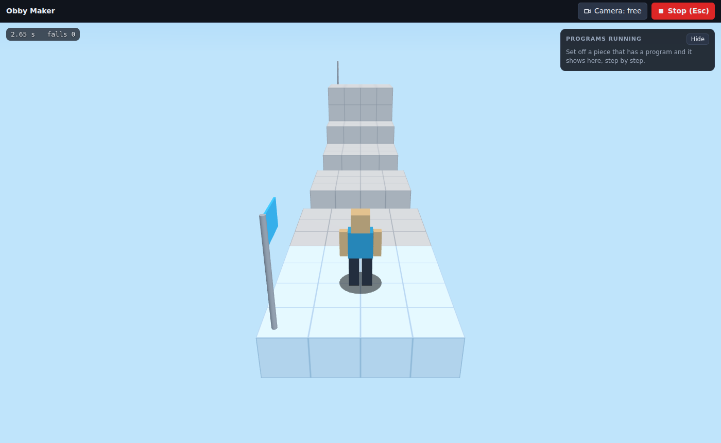
Obby Maker: Build a Fair Obby
Grades 4-8 · 45 minutes
Slides, rubric and answer key
Print and go
No student accounts
Notes:
Project this as students come in. Students play a three-stage obby and work out the rule behind every jump: 4 blocks across or 2 up, never 5. They build a stage of their own, and the app tells them in a sentence whether it can be finished. At the end, classmates trade seats and play each other's stages.

Slide 2
Essential question
What makes an obstacle course hard but fair?
Notes:
Read it aloud. Come back to it at the end of the lesson.

Slide 3
Today I can
1
I can explain the difference between a jump that is hard but fair and one that nobody can make.
2
I can use the jump rule (4 blocks across or 2 up) to place platforms a runner can reach.
3
I can place a checkpoint so a fall sends the runner back a short way, not to the start.
4
I can test a stage by playing it from start to finish, and fix the jumps that fail.
5
I can improve a stage using what a classmate's playtest shows.
Notes:
The objectives as I can statements. Read them aloud, and come back to them at the end of the lesson.

Slide 4
Warm-up
Which jump was the hardest? Could anyone make it?
Notes:
Warm-up, minutes 0 to 7. Show the title, essential question and Today I can slides (about 1 minute). Then have students open the link or scan the QR code on the worksheet and press Play the course, which plays all three stages in order (Play plays only one stage). A short guide runs along the app; tell students to do its first step, then press Esc and wait when they finish. They run with the arrow keys or W A S D and jump with Space; Esc stops. Tell them not to press New: it replaces the whole course (Undo brings it back). Ask: "Which jump was the hardest? Could anyone make it?"

Slide 5
Words we will use
obby
An obstacle course game. The runner jumps from piece to piece to reach the finish.
runner
The character you move through the obby.
stage
One part of an obby, from a start pad to a finish pad.
checkpoint
A pad the runner goes back to after a fall.
jump arc
The line that shows where a jump lands while you place a piece. Blue lands. Red does not.
fair
Hard, but possible. A player can do it with practice.
playtest
Playing someone's game to find out what works and what does not.
Can it be finished?
The box in the stage panel that says, in a sentence, whether a runner can reach the finish.
Notes:
Point at each word on the screen the first time the lesson uses it.

Slide 6
The jump rule
4
2
blocks across: the farthest a running jump goes
blocks up: the highest a jump climbs
A gap of 5 never works. That is not hard. It is broken.
Notes:
Direct instruction (I do), minutes 7 to 15. Show the vocabulary slide. Then, on the projector, press Esc and press + stage. Read the red sentence under Can it be finished? aloud: nothing reaches the finish, and the finish is 20 across from the start. Pick Platform and place one with a gap of 3 blocks from the start pad. Drag it 1 block farther at a time while the class watches the jump arc: blue at 3 and 4, red at 5. Say the jump rule: a running jump clears 4 blocks across or 2 up, and a gap of 5 never works. Then explain fair hard and broken hard. Pick Checkpoint and show where it goes: just before the hard jump, so a fall there sends the runner back a short way. Point out the one in the course: in stage 2, Lava Floor, the last stepping stone before the bounce pad is a checkpoint.

Slide 7
Fair hard or broken hard?
Rule 1
Rule 2
Fair hard: possible, with practice.
Broken hard: nobody can make it, however many tries.
A checkpoint just before a hard jump keeps a fall from costing the whole stage.

Slide 8
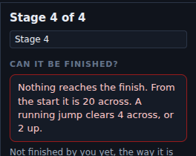
The app checks every stage
Read the sentence. It says why the finish cannot be reached yet, and how far it is.

Slide 9
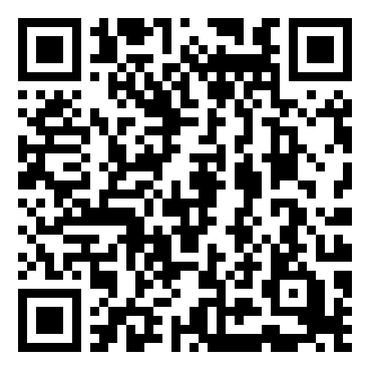
Together: your first stage
1
Press + stage at the bottom of the screen.
2
Read the red sentence under Can it be finished?
3
Add platforms from the start toward the finish.
Scan the QR code, or go to
mytekdev.com/try/obby?lesson=build-a-fair-obby
4
Press Play and run to the finish, until it says done.
Notes:
Guided practice (We do), minutes 15 to 23. Have everyone press + stage at the bottom of the screen. Students who followed the guide already did; they keep that stage and do not press it again. Read the red sentence together: the finish is 20 blocks from the start. Place one platform 4 blocks from the start together, and check that the jump arc is blue. Before you move on, check that every student has at least one platform the runner can reach. Play from here does not count toward done: use Play.

Slide 10
Build your stage
Rule 1
Rule 2
Rule 3
One jump that is hard, but fair.
A checkpoint just before the hard part.
Play it to the finish yourself.
Sketch your hard jump on the worksheet before you build it.
Notes:
Independent practice (You do), minutes 23 to 37. Walk the room and ask the questions under What to look for. Repeat the three rules: one jump that is hard but fair, a checkpoint just before it, and play it to the finish until the stage says done.

Slide 11
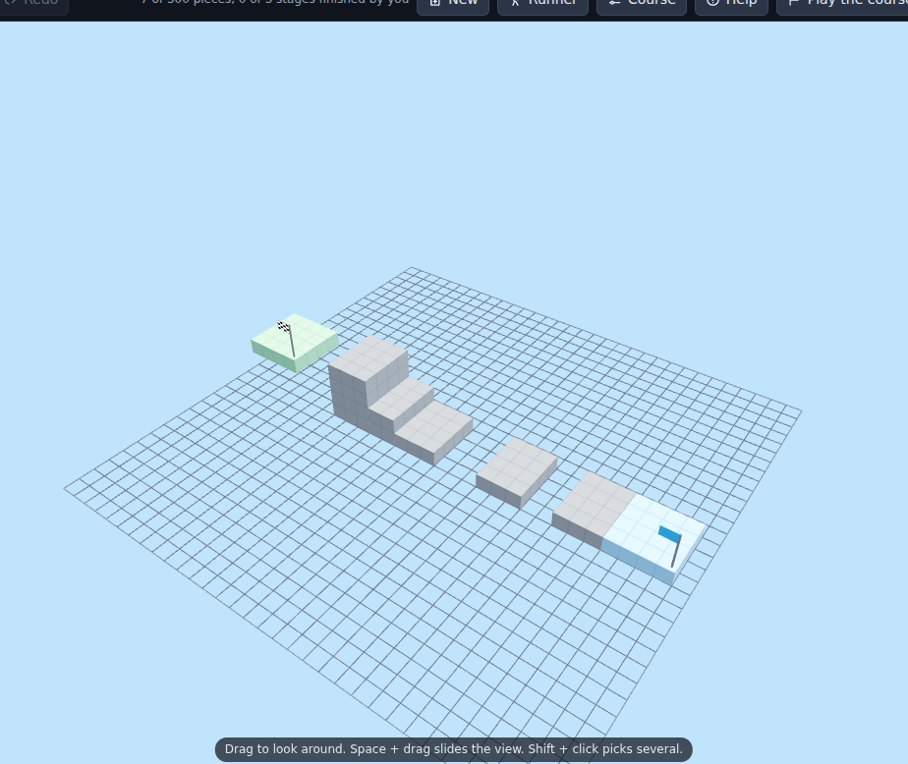
Playtest
Where did your classmate get stuck? Did you mean it?
Notes:
Closure, minutes 37 to 45. Students trade seats and play a classmate's new stage for about 3 minutes. The builder watches and says nothing. Then builders go back to their own seats and make one change where the classmate got stuck, or decide it was meant to be hard (about 2 minutes). Ask the essential question again, then hand out the exit ticket.

Slide 12
Back to our question
What makes an obstacle course hard but fair?
Notes:
Ask the essential question again before the exit ticket.

Slide 13
Exit ticket
Answer on your own, on your exit ticket or in your notebook.
1. A running jump clears 4 blocks across. A gap of 5 blocks is:
A. hard but fair
B. easy
C. impossible: nobody can make it
2. Why put a checkpoint just before a hard jump?
A. it makes the jump shorter
B. a fall at the jump sends the runner back a short way, not to the start
C. it makes the runner jump higher
3. A classmate's stage has a gap of 5 blocks between two platforms. Name one change that makes the jump fair but still hard.
Notes:
Hand out the exit ticket, or have students answer in their notebooks. The answer key is in the plan.

