Slide 1
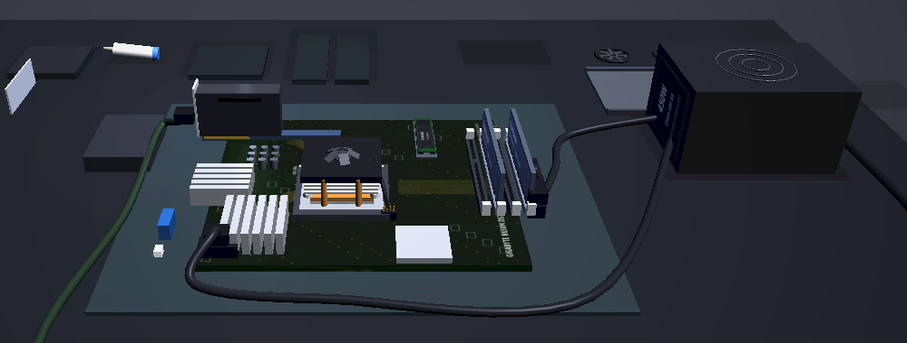
PC Workshop: Build a Computer and Boot It
Grades 5-8 · 45 minutes
Slides, rubric and answer key
Print and go
No student accounts
Notes:
Project this as students come in. Students build a computer from real parts on a 3D workbench: the CPU into its socket, thermal paste and a cooler, memory, a drive, a graphics card and the cables. They press POWER and the computer checks itself, part by part. Then they take one part out at a time, predict what the computer will say, and turn it on to find out, until they can tell what every part does from what goes wrong without it.

Slide 2
Essential question
How do the parts of a computer work together, and how can you tell what each part does?
Notes:
Read it aloud. Come back to it at the end of the lesson.

Slide 3
Today I can
1
I can name the main parts of a computer and say what each one does.
2
I can put the parts together in a working order, and explain why some steps come before others.
3
I can explain what a computer checks when it starts, and what one short beep means.
4
I can predict what a computer will do when one part is missing, then test the prediction.
5
I can use a symptom, like three beeps or no signal, to name the part to check first.
Notes:
The objectives as I can statements. Read them aloud, and come back to them at the end of the lesson.

Slide 4
Warm-up
You press the power button and the computer does not start. What could be wrong?
Notes:
Warm-up, minutes 0 to 5. Show the title, essential question and Today I can slides (about 1 minute). Show the warm-up slide and ask: "You press the power button and the computer does not start. What could be wrong?" Write every answer on the board and keep the list for the end. Then have students open the link or scan the QR code on the worksheet. The workbench opens with every part on the shelf and an empty motherboard. A short guide takes them to 1. Choose, where they click the part names on the left to read what each part does, then back to 2. Build to wait. Warn them: on 1. Choose, click only the names on the left; a card on the right changes the parts.

Slide 5
Words we will use
CPU
The processor: the part that runs every instruction. It sits in a socket on the motherboard.
motherboard
The board every other part plugs into, so the parts can work together.
memory (RAM)
Where the CPU keeps what it is working on right now. It is emptied when the power goes off.
storage (drive)
Where programs and files are kept, even with the power off. The computer starts from it.
graphics card
Draws the picture on the monitor. Some CPUs can draw a picture without one.
power supply
Turns power from the wall into the power every part needs.
cooler
Carries heat away from the CPU. Thermal paste fills the gap between them.
POST
Power-on self-test: the checks a computer runs on its own parts each time it starts.
Notes:
Point at each word on the screen the first time the lesson uses it.

Slide 6
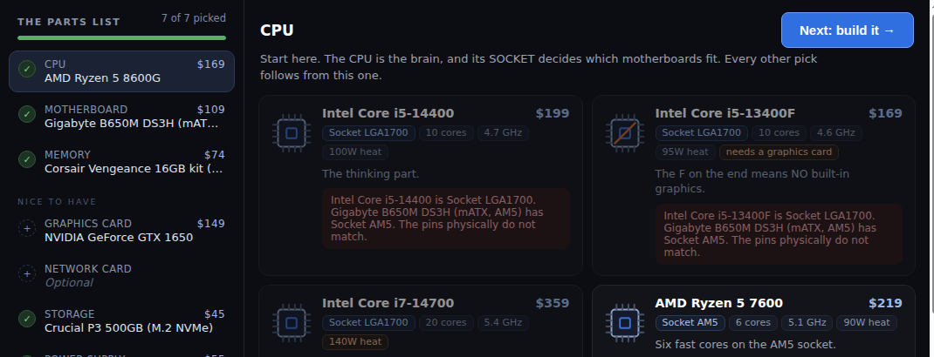
Every part has a job
Open 1. Choose and click each part name on the left to read what it does. The cards on the right change the parts: leave them alone today.
Notes:
Direct instruction (I do), minutes 5 to 12. Show the vocabulary slide. On the projector, open 1. Choose and click each part name in The parts list, on the left only. The app says what each one does in one sentence (the CPU is the brain; memory is the CPU's desk; storage is where everything lives). Point out that the graphics card is under Nice to have: this CPU can draw a picture by itself. Then show the next slide: when a computer starts, it checks its own parts in order, the CPU, then the memory, then the graphics, then for a drive to start from, then the cooler. This is called POST. One short beep means every check passed. Open 2. Build again.

Slide 7
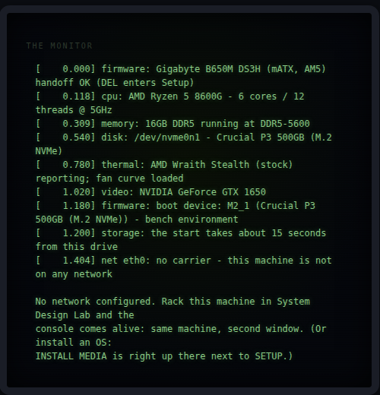
The computer checks itself
When it starts, it checks the CPU, then the memory, then the graphics, then for a drive to start from, then the cooler. One short beep: every check passed. Then it lists what it found.

Slide 8
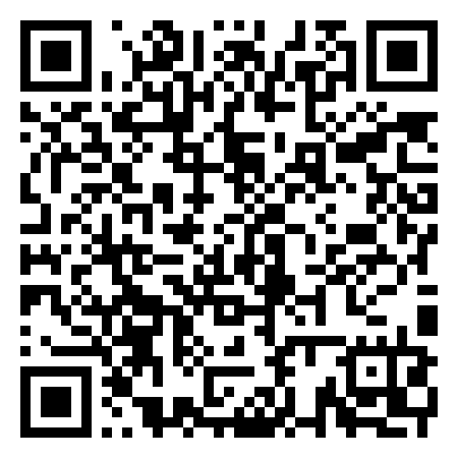
Together: the first two steps
1
Seat the CPU: turn it until the gold triangles share a corner, click the socket, close the load plate, press the lever.
2
Pick up the thermal paste and press and hold on the CPU.
3
Put the cooler on, then tighten its four screws a little at a time, corner to corner.
Scan the QR code, or go to
mytekdev.com/try/pcworkshop?lesson=build-a-computer-and-boot-it
4
Plug the cooler's fan cable into CPU_FAN.
Notes:
Guided practice (We do), minutes 12 to 20. On the projector, do the first two steps of The build list, one action at a time, while students copy you. Seat the CPU: pick it up, turn it with Rotate / flip until the two gold triangles are in the same corner, click the socket, close the load plate and press the lever down. Then the cooler: thermal paste goes on first (pick up the tube and press and hold on the CPU), then set the cooler on and tighten its four spring screws a little at a time, corner to corner, then plug its small fan cable into CPU_FAN. Explain why the paste comes first: it fills the tiny air gaps so heat can reach the cooler. Hand out the build guide: steps 1 and 2 are what the class just did. Point out the gold ring: it marks the next thing to click. If a student does not see it, Help me turns it back on (and off).

Slide 9
Build it, then break it
Rule 1
Rule 2
Rule 3
Finish all 8 steps with your build guide. Plug the monitor into the graphics card.
Press Next: turn it on, then POWER. Listen for one short beep.
Take a part out and predict. Then open 3. Boot and press POWER.
Put each part back before the next one, and save the cooler for last. Skip the INTO THE CASE steps today.
Notes:
Independent practice (You do), minutes 20 to 37. Students finish the 8 steps on their own with the build guide: the memory (each stick turned with Rotate / flip first, then pressed down on both ends until the clips snap), the M.2 drive, the graphics card, the power cables, the monitor cable and the wall power with its switch. Tell them to plug the monitor cable into the graphics card, not the motherboard, or the graphics card experiment shows nothing. When every step has a tick, they press Next: turn it on, then POWER, and listen for one short beep. After that first boot the list grows by the INTO THE CASE steps: students skip them today. Then the experiments: Take a part out (bottom right, beside Reset view), click a part, predict on the worksheet, then open 3. Boot and press POWER. Both memory sticks means pressing it twice. Students put each part back before the next experiment, and save the cooler for last: putting it back means new paste, the cooler, four screws and the fan cable. Walk the room and ask the questions under What to look for.

Slide 10
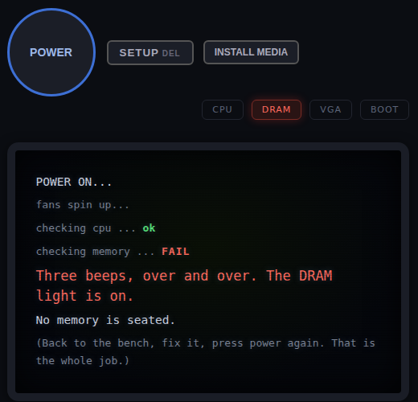
A symptom names the suspect
Both memory sticks out: three beeps, and the DRAM light comes on.

Slide 11
Back to the warm-up
Look at our list. Which part would you check first for each problem, and why?
Notes:
Closure, minutes 37 to 45. Go back to the list on the board from the warm-up. For each problem, ask which part the class would check first now, and what the computer would show. Ask the essential question again, then hand out the exit ticket.

Slide 12
Back to our question
How do the parts of a computer work together, and how can you tell what each part does?
Notes:
Ask the essential question again before the exit ticket.

Slide 13
Exit ticket
Answer on your own, on your exit ticket or in your notebook.
1. A computer gives three beeps, and the DRAM light is on. Which part should you check first?
A. the drive
B. the memory
C. the graphics card
2. A computer starts, then says "No boot device found." What is missing?
A. the drive the computer starts from
B. the CPU
C. the power cable
3. The cooler was taken off. The computer starts, then shuts itself off a few seconds later. Explain what the cooler does, and why the computer turned itself off.
Notes:
Hand out the exit ticket, or have students answer in their notebooks. The answer key is in the plan.

