Slide 1
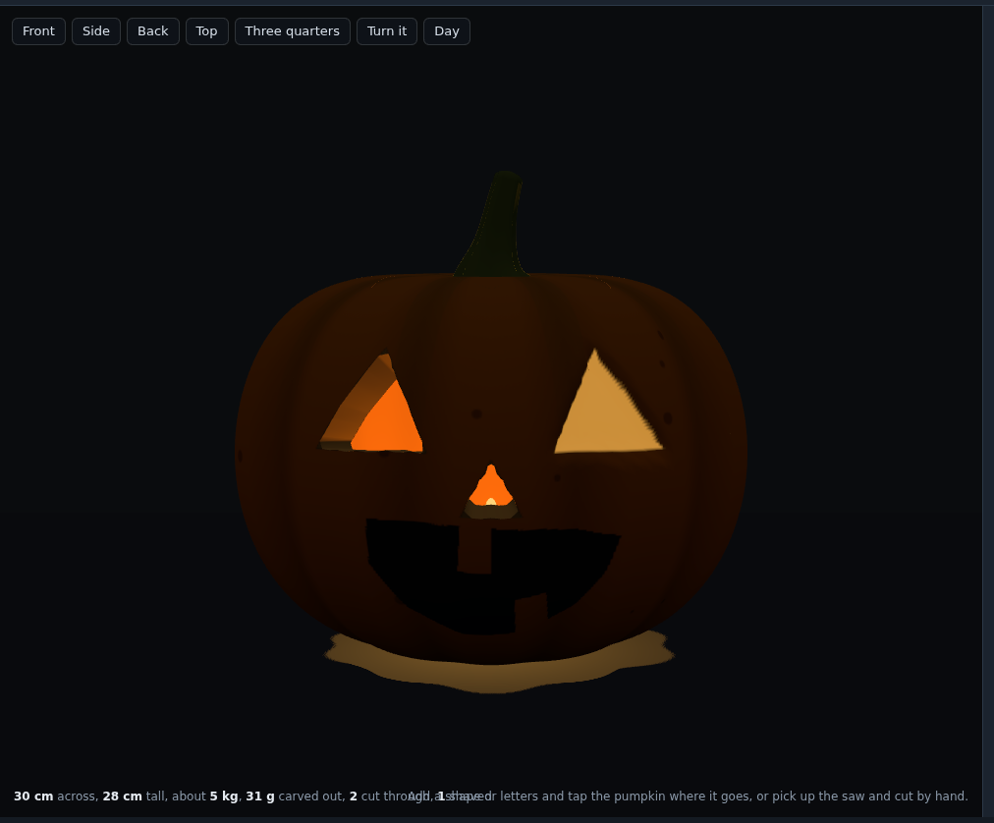
Pumpkin Lab: Light Through a Pumpkin
Grades 5-8 · 45 minutes
Halloween science
Light and shadows
Slides, rubric and answer key
Notes:
Project this as students come in. A jack-o'-lantern is a light experiment everyone has seen. In this lesson students open a 3D pumpkin whose face is carved three different ways: the left eye and the nose are cut all the way through, the right eye is only shaved (the skin peeled off, the flesh left), and the grin is only painted on. Before turning the lights off, they predict what each mark will do in the dark. Then they press Night and find out: the holes blaze and throw their shape onto the far wall, the shaved eye glows through the thin flesh but throws no shape, and the painted grin stays dark. They change a mark from one kind to another and test again, then grow an eye and watch its shape on the wall grow with it. By the end, students can describe light that is transmitted, partly transmitted and absorbed, and explain with straight-line rays why the face on the wall is bigger than the hole.

Slide 2
Essential question
Why does light come out of a jack-o'-lantern in some places and not others, and why is the face on the wall bigger than the face on the pumpkin?
Notes:
Read it aloud. Come back to it at the end of the lesson.

Slide 3
Today I can
1
I can predict and test which marks on a pumpkin let light through, let some through, or stop it.
2
I can describe light that is transmitted, partly transmitted and absorbed, using the pumpkin as evidence.
3
I can explain with straight-line rays why the face on the wall is bigger than the hole.
4
I can change one thing at a time and record what happens.
Notes:
The objectives as I can statements. Read them aloud, and come back to them at the end of the lesson.

Slide 4
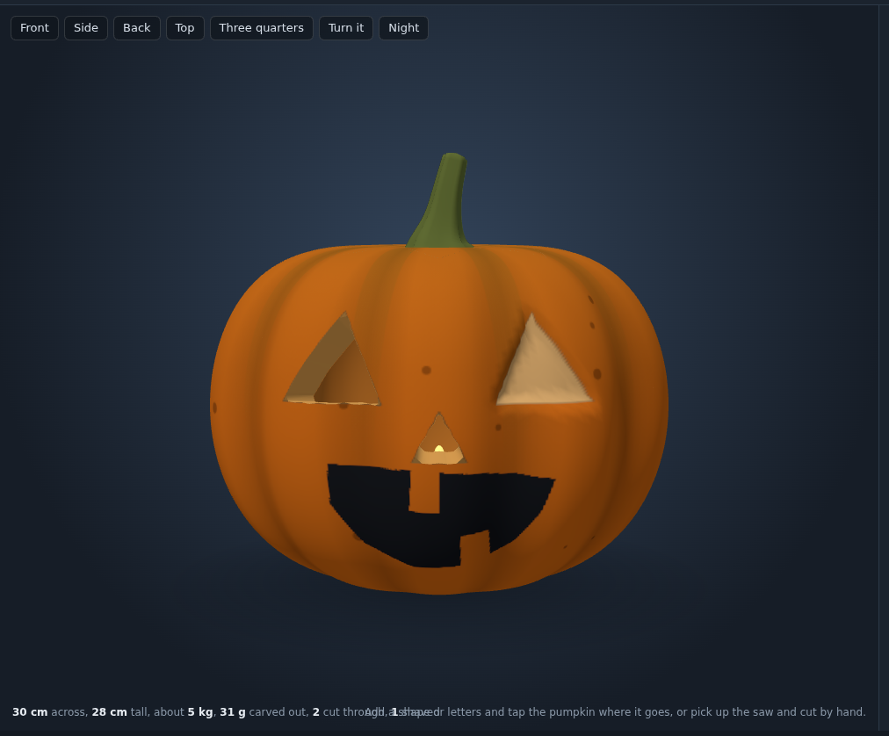
Warm-up
Three marks on one pumpkin: cut through, shaved, painted. In the dark, which ones will glow?
Notes:
Warm-up, minutes 0 to 7. Show the title, essential question and Today I can slides (about 1 minute). Then have students open the link or scan the QR code on the worksheet. The pumpkin on the screen has a face carved three ways. Click Carve at the top and read the list under Your cuts: 1. Triangle cut through, 2. Triangle shaved, 3. Triangle cut through, 4. Grin painted. Ask: "When we turn the lights off, which of these will glow, and which will throw light on the wall?" Students write a prediction for each mark in the worksheet's table before anyone presses Night.

Slide 5
Words we will use
transmitted
Light that passes through something, like light through a window or a hole.
absorbed
Light that is taken in by a material and does not come out the other side.
translucent
Letting some light through, but not a clear picture, like thin paper or a shaved pumpkin.
opaque
Letting no light through, like the thick skin of a pumpkin.
ray
A straight line showing the path light takes.
shadow
A dark area where light is blocked. Around a lit hole, the wall stays in shadow.
variable
The one thing you change in a test, while everything else stays the same.
Notes:
Point at each word on the screen the first time the lesson uses it.

Slide 6
Three ways light meets a pumpkin
Rule 1
Rule 2
Rule 3
Cut through: the light is transmitted, all the way out.
Shaved: the thin flesh lets some light through. It is translucent.
Painted or plain skin: the light is absorbed. It is opaque.
Light goes where the material lets it. A hole lets it all.
Notes:
Direct instruction (I do), minutes 7 to 15. Show the vocabulary and Three ways light meets a pumpkin. On the projector, press Night over the stage. The left eye and the nose blaze: they are holes, and the light from the candle is transmitted straight out. The right eye glows a duller orange: it was shaved, so the light comes through thin flesh, translucent, the way light comes through a hand held over a flashlight. The grin stays dark: paint on thick skin, and the skin absorbs the light. Point out the readout under the stage: 2 cut through, 1 shaved. Then press Back, the view button above the stage, to look past the pumpkin at the far wall: a bright shape lands there from the cut eye, much bigger than the eye.
It's working when: Night is the button over the stage (it reads Day while it is night); the Light bench has the same switch. The view buttons Front, Side, Back, Top and Three quarters sit in the same row.

Slide 7
Lights off
The holes blaze, the shaved eye glows, the painted grin stays dark.
Notes:
Guided practice (We do), minutes 15 to 25. Together, change the painted grin to a hole: click Carve, tap 4. Grin in Your cuts, and press Cut through. Ask for predictions, then press Night: now the grin blazes too. Each pair then chooses one test of its own, changing only one mark from one kind to another (Cut through, Shave the skin, Paint only), predicts, tests at Night, and records it. Remind them that one change at a time is what makes a result mean something: that one change is the variable.

Slide 8
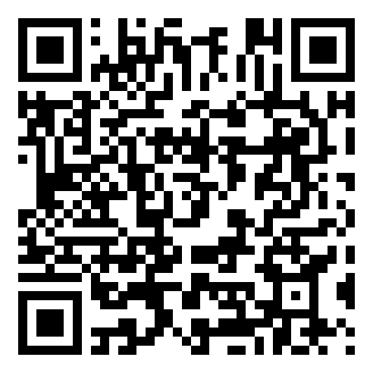
Together: test one change
1
Predict first, on the worksheet.
2
Tap a cut and change Cut through, Shave the skin or Paint only.
3
Press Night and look from the front and the Back view.
Scan the QR code, or go to
mytekdev.com/try/pumpkinlab?lesson=light-through-a-pumpkin
4
Write what happened. Change only one thing.

Slide 9
The face on the wall
Rule 1
Rule 2
Rule 3
Press the Back view to see the far wall.
Make one eye bigger with its Size slider.
Draw rays from the candle through the hole to the wall.
Light travels in straight lines, and the rays spread as they go.
Notes:
Independent practice (You do), minutes 25 to 38. Students press Night and then Back, to look at the far wall. They tap the cut-through left eye in Your cuts and move its Size slider, at night, and watch the shape on the wall. A bigger hole makes a bigger patch of light. Then they draw the worksheet's ray diagram: the candle as a dot, the eye as a gap in a line, the wall as a line, and straight rays from the candle through the top and bottom of the gap to the wall. The rays spread apart as they travel, so the patch on the wall is bigger than the hole. Walk the room and ask the questions under What to look for.
Watch for: Nothing glows: the light is set to No light on the Light bench; pick Candle again. A slow computer at night: turn Flickers off on the Light bench.
Watch for: The Front view hides the wall behind the pumpkin. The Back view looks past the pumpkin at the wall that the face shines on.

Slide 10
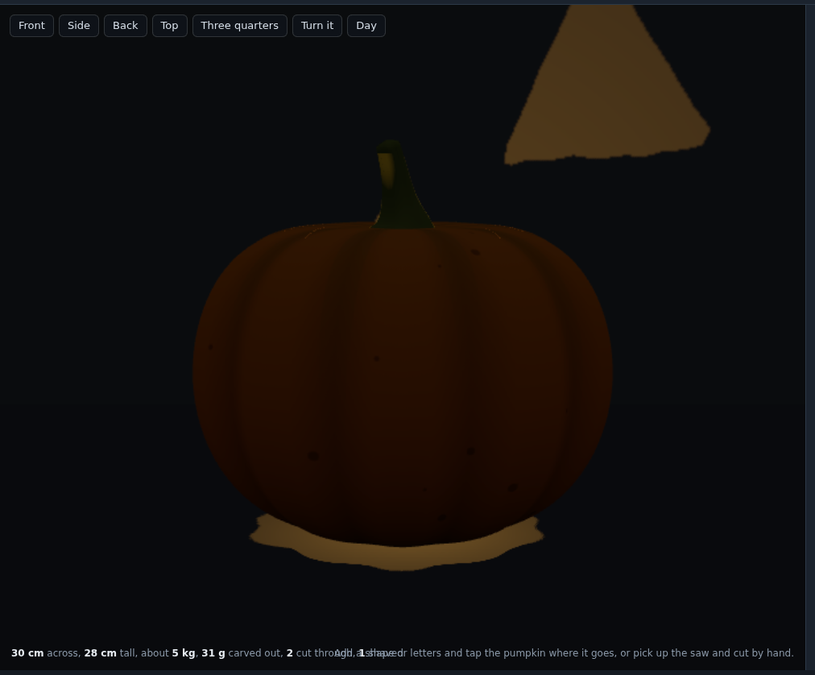
Explain it
The shaved eye glows, but it throws nothing on the wall. Why?
Notes:
Closure, minutes 38 to 45. Show the last slide and ask: "The shaved eye glows, but it throws nothing on the wall. Why?" (Light comes through the thin flesh but is scattered in every direction, so it does not travel on as a beam in the shape of the eye. Only a hole lets the rays through in straight lines.) Ask the essential question again, then hand out the exit ticket.

Slide 11
Back to our question
Why does light come out of a jack-o'-lantern in some places and not others, and why is the face on the wall bigger than the face on the pumpkin?
Notes:
Ask the essential question again before the exit ticket.

Slide 12
Exit ticket
Answer on your own, on your exit ticket or in your notebook.
1. Which mark throws its shape onto the wall at night?
A. painted
B. shaved
C. cut through
2. A shaved eye at night:
A. glows, but throws no shape on the wall
B. stays dark
C. throws a bigger shape than a hole
3. Why is the face on the wall bigger than the face on the pumpkin?
Notes:
Hand out the exit ticket, or have students answer in their notebooks. The answer key is in the plan.

