Slide 1
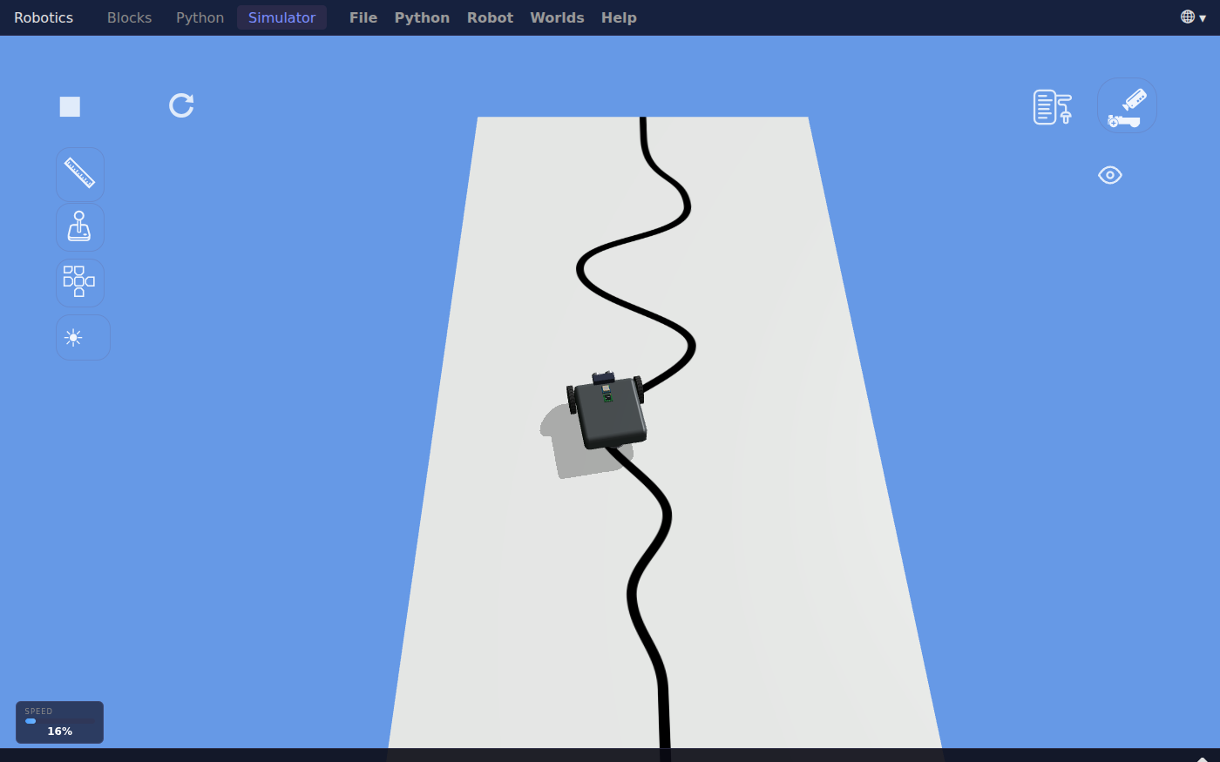
Robotics: Follow a Line with One Sensor
Grades 5-8 · 45 minutes
Slides, rubric and answer key
Print and go
No student accounts
Notes:
Project this as students come in. Students run a simulated robot that follows a black line using one light sensor. They watch the sensor read about 16 over the line and about 100 over the white mat, and find the program's rule: below 58, turn one way; otherwise, turn the other way, checked over and over. They predict what a gentler turn will do, see the robot run off the mat at the first curve, and then test other turn values as a class. By the end, they can explain how one sensor and one cut-off number keep a robot on a line it cannot see ahead of.

Slide 2
Essential question
How can a robot with one sensor stay on a line it cannot see ahead of?
Notes:
Read it aloud. Come back to it at the end of the lesson.

Slide 3
Today I can
1
I can explain how a light sensor and a cut-off number let the robot tell the black line from the white mat.
2
I can read an if-else inside a loop and say what the robot does over dark and over light.
3
I can predict how a changed turn value will change the drive, then test it and record what happened.
4
I can use the class's test results to choose a turn value and explain why a turn that is too gentle cannot follow a curve.
Notes:
The objectives as I can statements. Read them aloud, and come back to them at the end of the lesson.

Slide 4
Warm-up
This robot cannot see the line ahead of it. How does it stay on the line?
Notes:
Warm-up, minutes 0 to 7. Show the title, essential question and Today I can slides (about 1 minute). Then have students open the link or scan the QR code on the worksheet. The app opens on the Simulator with the robot at the bottom of a long white mat and a curvy black line. A short guide runs along the bottom: tell students to do its first step only, which is to press Run (the play button) and watch, then wait. The robot follows the line to the far end of the mat and stops. Ask: "This robot cannot see the line ahead of it. How does it stay on the line?"

Slide 5
Words we will use
sensor
A part that measures something about the world. This robot's light sensor points down and measures how much light the mat reflects.
intensity
How much light comes back to the sensor, from 0 to 100. Black reflects little, white reflects a lot.
threshold
A cut-off number. Readings below it count as the line, and readings above it count as the mat.
condition
A question the program asks that is true or false, like: is the reading less than 58?
loop
Part of a program that repeats. This one repeats while the robot's GPS y is less than 90, which is near the far end of the mat.
variable
A named value the program can use in more than one place. Here, turn sets how hard the robot steers.
test
Running the program on purpose to find out what it does, and writing down the result.
Notes:
Point at each word on the screen the first time the lesson uses it.

Slide 6
What the sensor reads
16
100
58
over the black line
over the white mat
the cut-off in the program
Below 58 counts as the line. Above 58 counts as the mat.
Notes:
Direct instruction (I do), minutes 7 to 17. On the projector, press reset (the circle arrow next to Run), open the sensor readings with the sensors button at the top right (it looks like a page of lines, just left of the camera button), and press Run. Point to Intensity (%) under in1: Color Sensor: it drops to the teens over the black line and rises to about 100 over the white mat. Show the What the sensor reads slide and the vocabulary. Then open Blocks and read the program from the top: set turn to 40; repeat while gps y is less than 90 (near the far end of the mat); inside it, if color_sensor reflected light intensity is less than 58, move steering with direction turn and speed 20, else the same block with minus turn; then sleep for 10 milliseconds. Say: the robot has one sensor, so it only ever knows dark or light. Over dark it turns one way and over light the other, so it zigzags along the edge of the line, checking many times a second.
It's working when: The readings list shows every sensor on the robot. The one for this lesson is in1: Color Sensor, row Intensity (%).

Slide 7
The program's rule
Rule 1
Rule 2
Rule 3
If the reading is below 58, steer one way by turn.
Otherwise, steer the other way by turn.
Sleep for 10 milliseconds, then check again, until GPS y reaches 90.
It never drives straight. It keeps crossing the edge of the line and correcting.

Slide 8
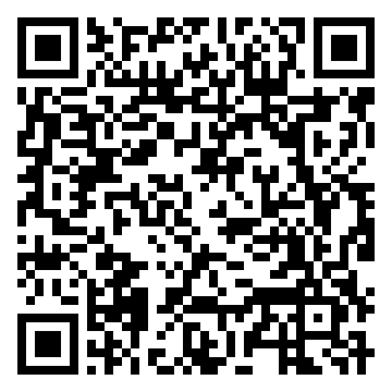
Together: predict, then test
1
Open Blocks. Find set turn to 40.
2
Change 40 to 10.
3
Write what you think the robot will do.
Scan the QR code, or go to
mytekdev.com/try/robotics?lesson=follow-a-line-with-one-sensor
4
Go to Simulator, press reset (the circle arrow), then Run.
Notes:
Guided practice (We do), minutes 17 to 25. Together: in Blocks, change set turn to 40 to 10. Before anyone presses Run, students write a prediction in the table. Then go back to the Simulator, press reset, then Run. The robot runs off the mat at the first curve: its swings are too gentle to follow the bend. Show the One number, two robots slide. Set turn back to 40. Before moving on, check that every table has a prediction and a result for this row.
Watch for: Run and reset are on the Simulator tab only. Run starts from wherever the robot is now, so a robot that was not reset starts at the far end or off the mat, and the result makes no sense.

Slide 9
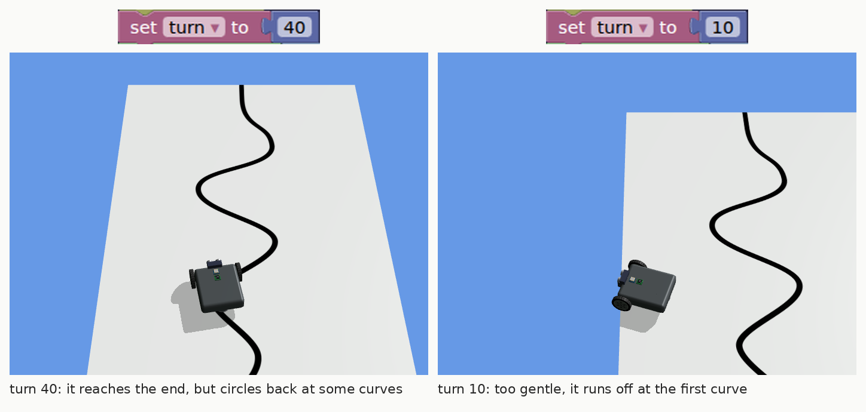
One number, two robots
At 40 the robot reaches the end, though at some curves it swings off the line, circles, and finds it again. At 10 the swings are too gentle, and it runs off the mat at the first curve.

Slide 10
Test it as a class
Rule 1
Rule 2
Rule 3
Test your two turn values. Predict before each Run.
Record: reached the end, came back to the line, or ran off.
Add your results to the class table.
Reset before every Run. Run starts from wherever the robot is now.
Notes:
Independent practice (You do), minutes 25 to 38. Give each pair two turn values from the class table (20, 30, 50, 60, 70, 80), so every value is tested by at least two pairs on different computers. For each value they predict, reset and Run, and record one of three results: reached the end, left the line and came back, or ran off the mat. Each run goes on until the robot stops at the far end or leaves the mat, which can take about two minutes. As pairs finish, they add tally marks to the board. Walk the room and ask the questions under What to look for. When the table is full, ask: which value would you choose, and what is your evidence?
Watch for: In our tests, each value in the table gave the same result on fast and slow computers, though the times differed. Turn 40 reaches the end, but at some curves it circles off the line before finding it again, so it belongs under Left the line and came back. Turn 30 circles off the line and back for a minute or more before it runs off the mat, so it belongs under Ran off the mat; a pair that stops watching early records it as came back. Turn 80 stays on the line but crawls, and takes about two minutes to reach the end. If two pairs report different results for the same value, first check that both pressed reset before Run, then treat the split as data for the closing question, not as a mistake.
Watch for: A student who edits the Python tab gets a warning, and from then on Run uses the Python and ignores the blocks. Keep changes in Blocks.

Slide 11
Read the data
Turn 10 ran off the mat and turn 40 reached the end. Why does a harder turn help on a curve?
Notes:
Closure, minutes 38 to 45. Show the last slide and ask: "Turn 10 ran off the mat and turn 40 reached the end. Why does a harder turn help on a curve?" (The robot cannot see the curve coming. It only finds out it has left the line when the sensor reads light, and each correction has to swing it back before it drives off. A gentle turn swings back too slowly to keep up with the bend. If any pairs reported different results for the same value, ask what they would check first: was the robot reset, and were the blocks changed?) Ask the essential question again, then hand out the exit ticket.

Slide 12
Back to our question
How can a robot with one sensor stay on a line it cannot see ahead of?
Notes:
Ask the essential question again before the exit ticket.

Slide 13
Exit ticket
Answer on your own, on your exit ticket or in your notebook.
1. The light sensor reads 20. Where is it most likely to be?
A. over the black line
B. over the white mat
C. you cannot tell
2. The program says: if intensity is less than 58, steer one way, else steer the other way. Why does the robot zigzag instead of driving straight?
A. the line is crooked
B. it only knows dark or light, so it keeps turning back across the edge
C. the motors are uneven
3. With turn set to 10, the robot ran off the mat at the first curve. What would you try next, and why?
Notes:
Hand out the exit ticket, or have students answer in their notebooks. The answer key is in the plan.

