Slide 1
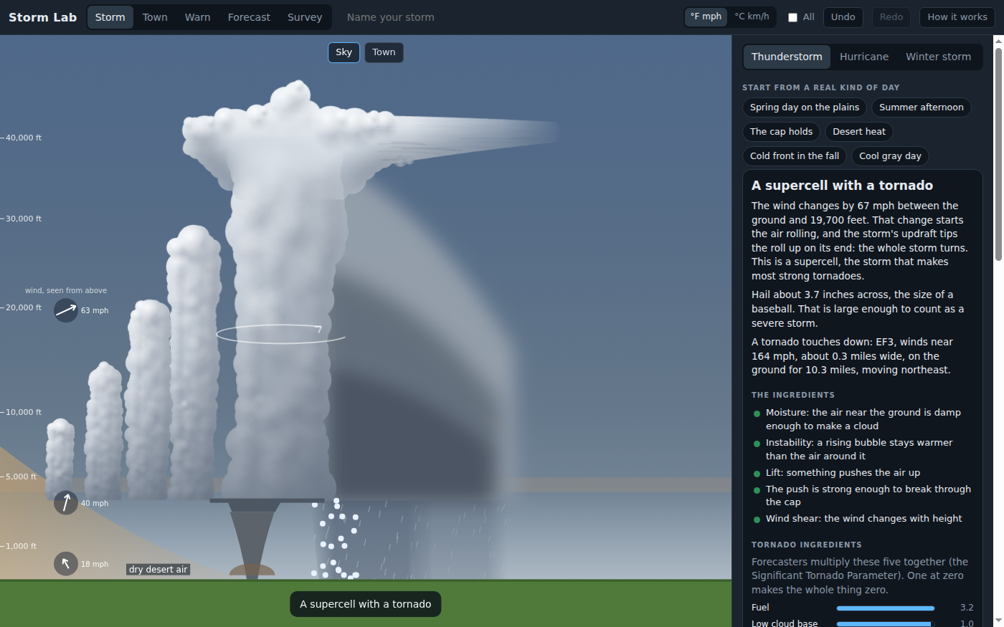
Storm Lab: What Makes a Thunderstorm?
Grades 6-8 · 45 minutes
Slides, rubric and answer key
Print and go
No student accounts
Notes:
Project this as students come in. Students make a thunderstorm from a hot, humid summer afternoon, then take its ingredients apart one at a time. A little drier air, and the result says the cap held; drier still, and only small clouds form; nothing to lift the air, and there is no storm at all. Then they fix days that make no storm, a capped spring day and a dry desert day, by changing one ingredient and predicting each result first. By the end, they can explain the three ingredients forecasters check for a thunderstorm, and why plenty of fuel is not enough on its own.

Slide 2
Essential question
What does the air need to make a thunderstorm?
Notes:
Read it aloud. Come back to it at the end of the lesson.

Slide 3
Today I can
1
I can name the three ingredients of a thunderstorm, moisture, instability and lift, and say what each one does.
2
I can explain how a cap of warm air can delay or stop a storm even when there is plenty of fuel.
3
I can predict what removing or adding one ingredient will do, then test it and record the result.
4
I can fix a day that makes no storm by changing one ingredient, and explain which ingredient was missing.
Notes:
The objectives as I can statements. Read them aloud, and come back to them at the end of the lesson.

Slide 4
Warm-up
A hot, humid afternoon turns into a thunderstorm. What did the air need?
Notes:
Warm-up, minutes 0 to 7. Show the title, essential question and Today I can slides (about 1 minute). Then have students open the link or scan the QR code on the worksheet. The app opens on the Storm bench with a hot, humid summer afternoon already set. A short guide runs along the bottom: tell students to do its first step only, which is to press Make the storm and watch the sky, then wait. A tall cloud grows and the result reads `An ordinary thunderstorm`. Ask: "What did the air need to make this storm?"

Slide 5
Words we will use
moisture
Water vapor in the air. Damp air makes a cloud sooner as it rises.
instability
When a rising bubble of air stays warmer than the air around it, so it keeps rising. The app calls it fuel.
lift
Something that pushes air up to start it rising: the sun heating the ground, a hill, a sea breeze, a dry line or a cold front.
cap
A layer of warmer air partway up that works like a lid. A rising bubble has to be pushed through it.
dew point
The temperature air must cool to before its water vapor turns into cloud. The closer it is to the air temperature, the damper the air.
wind shear
A change in the wind's speed or direction with height. It organizes storms but is not needed to start one.
Notes:
Point at each word on the screen the first time the lesson uses it.

Slide 6
Three ingredients
Moisture
Instability
Lift
damp air near the ground, to make a cloud
a rising bubble that stays warmer than the air around it
something to push the air up and start it rising
Forecasters check all three. Take one away and there is no thunderstorm.
Notes:
Direct instruction (I do), minutes 7 to 17. Show the Three ingredients slide and the vocabulary. On the projector, scroll to `The ingredients` under the result. Each line has a dot: green means this sky has it. Read the first three: moisture, instability (the app also calls it fuel), and lift. Point out that `Wind shear` is not green, yet there is a storm: shear organizes storms and helps them last, but a storm can form without it, and this one rains itself out within about an hour. Then show The cap slide: a layer of warmer air partway up works like a lid, and the line `The push is strong enough to break through the cap` says whether the lift got a bubble through it. Today the sun heating the ground was enough.
It's working when: The sliders for temperature, humidity, how fast it gets colder and the cap show words, not numbers (humidity also shows a percent). The All checkbox at the top shows the numbers; leave it off for this lesson.

Slide 7
The cap
Rule 1
Rule 2
Rule 3
A layer of warmer air partway up works like a lid.
A bubble has to be pushed through it before it can rise on its own.
Plenty of fuel under a strong lid can still mean no storm.
In the app, the result says when the cap held.

Slide 8
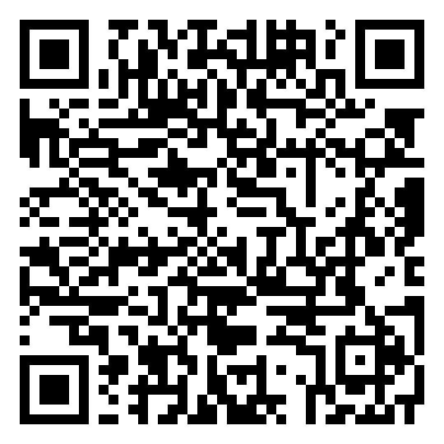
Together: take one away
1
Make the storm on the summer afternoon.
2
Predict: what happens with drier air?
3
Drag Humidity near the ground a little toward dry.
Scan the QR code, or go to
mytekdev.com/try/stormlab?lesson=what-makes-a-thunderstorm
4
Make the storm again. Read the title and the ingredients.
Notes:
Guided practice (We do), minutes 17 to 25. Together: before anyone moves a slider, students write a prediction for drier air. Then drag `Humidity near the ground` a little toward dry, a notch or two past where the word changes from humid, and press Make the storm. The result reads `The cap held`: the air still has fuel, but drier air has to rise further before it makes a cloud, and the sun's push no longer gets it through the lid. Drag it further toward dry and make the storm again: `Small clouds, no storm`, with almost no fuel. Put the humidity back (Undo works). Last, press `nothing pushing the air up` under What pushes the air up, and make the storm: `No storm yet`. Ask which ingredient was missing each time.
Watch for: A slider change clears the result, so students have to press Make the storm again after every change. Run it again keeps the same sky with a new roll of the dice; it is not needed today.

Slide 9
Fix a day
Rule 1
Rule 2
Rule 3
Pick The cap holds or Desert heat. Make the storm and read why it failed.
Change one thing. Write your prediction first.
Make the storm again and record the result.
Read What would make a storm, under the result, only after you have written your own idea.
Notes:
Independent practice (You do), minutes 25 to 38. Students pick a day under Start from a real kind of day. First `The cap holds`: make the storm and read why it failed (plenty of fuel, but the sun is not enough push to get through the strong lid). Students change one thing, writing a prediction first. Three single changes work: a stronger lift (`wind blowing up a hillside`, `dry line, where desert air pushes into moist air` or `cold front`), weakening the cap into the lower part of `a firm lid` or to `a weak lid`, or a little more humidity. Then `Desert heat`: `No cloud`, because the air is so dry a bubble would rise about 15,600 feet before it made a cloud. Students find that humidity alone has to rise from 10 percent to about 45 percent before a storm forms, far more than The cap holds needed; on the way there, the result reads `The cap held`. Walk the room and ask the questions under What to look for. Whenever a day makes no storm, the app shows `What would make a storm` under the result: the smallest single changes, measured by the app's model, each with a Try it button. Ask students to read it and press Try it only after their own prediction is written.
Watch for: On The cap holds, weakening the cap or adding humidity makes a supercell, and with the lesson's starting settings the result is `A supercell with a tornado`, an EF3. Treat it like the rest of the lab: a science result, not a disaster. Some students may have lived through severe weather. How often a supercell makes a tornado in the app is the lab's own rule: forecasters can say when the air is the kind that has made strong tornadoes before, but not which storm will make one, and as few as 20 percent of supercells do.
Watch for: The Thunderstorm, Hurricane and Winter storm buttons switch kinds of storm. Keep everyone on Thunderstorm.

Slide 10
Explain it
There was plenty of fuel under the cap. Why did nothing happen until something changed?
Notes:
Closure, minutes 38 to 45. Show the last slide and ask: "There was plenty of fuel under the cap. Why did nothing happen until something changed?" (A bubble has to be pushed through the warm lid before it can rise on its own. The sun alone was not enough push; a hill, a dry line or a front pushes harder, and a weaker lid needs less push.) Ask the essential question again, then hand out the exit ticket.

Slide 11
Back to our question
What does the air need to make a thunderstorm?
Notes:
Ask the essential question again before the exit ticket.

Slide 12
Exit ticket
Answer on your own, on your exit ticket or in your notebook.
1. Which of these is NOT one of the three ingredients of a thunderstorm?
A. moisture
B. lift
C. wind shear
D. instability
2. A day has plenty of fuel, but a strong cap. The only lift is the sun heating the ground. What is most likely?
A. a thunderstorm
B. no storm
C. a hurricane
3. A very hot day makes no cloud at all. Which ingredient is most likely missing, and what would you change?
Notes:
Hand out the exit ticket, or have students answer in their notebooks. The answer key is in the plan.

