Slide 1
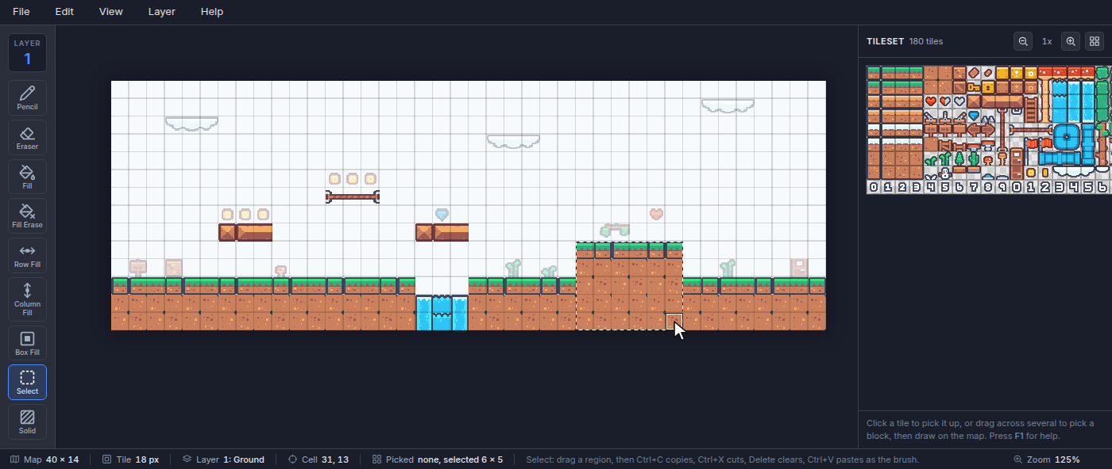
Tilemap Editor: How Big Is This Level?
Grades 3-5 · 45 minutes
Slides, rubric and answer key
Print and go
No student accounts
Notes:
Project this as students come in. Grassy Hills is a video game level made of square tiles, 40 across and 14 down. Students measure it the way the game does: they count the tiles in the hill, then find a faster way by multiplying its sides, and check with the editor's Select tool, which reports the size of whatever they drag over. Then they split the whole ground into rectangles and add the parts, read where things are by column and row, and build a castle of exactly 24 tiles from two rectangles.

Slide 2
Essential question
How can you find the area of a shape without counting every square?
Notes:
Read it aloud. Come back to it at the end of the lesson.

Slide 3
Today I can
1
I can find the area of a rectangle by counting unit squares, then by multiplying its side lengths.
2
I can find the area of a shape made of rectangles by splitting it into parts and adding them.
3
I can name a cell by its column and row, and count columns correctly from a start column to an end column.
4
I can build a shape with a given area and check it.
Notes:
The objectives as I can statements. Read them aloud, and come back to them at the end of the lesson.

Slide 4

Warm-up
This level is built from square tiles. How many tiles is the hill?
Notes:
Warm-up, minutes 0 to 6. Show the title, essential question and Today I can slides (about 1 minute). Students open the link or scan the QR code on the worksheet. The level is Grassy Hills, a strip of a platform game. A short guide runs along the top; have students do its three steps, which turn off View > Solid Cells (a red film that marks the solid blocks a player cannot walk through) and click the Select tool, but not drag yet. Ask: "This level is built from square tiles. How many tiles is the hill?" Let students count however they like.

Slide 5
Words we will use
tile
One small square picture. A game level is built from tiles placed on a grid.
grid
Rows and columns of squares, like graph paper.
area
How many squares a shape covers. Here the unit is one tile.
rectangle
A shape with four square corners. Its area is length times width.
column
A line of squares going up and down. The editor numbers them from 0 at the left.
row
A line of squares going side to side. The editor numbers them from 0 at the top.
Notes:
Point at each word on the screen the first time the lesson uses it.

Slide 6
Count, or multiply
6 x 5
30 tiles
6 columns, 5 rows
the hill's area
Every row of a rectangle has the same number of tiles, so rows times tiles in a row is the area.
Notes:
Direct instruction (I do), minutes 6 to 14. Collect counting methods: one by one, by rows, by columns. Then show the faster way on the board: the hill is 6 tiles across and 5 tiles down, every row has 6 tiles, so 5 rows of 6 is 6 x 5 = 30. On the projector, pick the Select tool (the dashed square, or press M) and drag from the hill's top left tile to its bottom right tile. The status bar at the bottom says Picked none, selected 6 x 5. Point out the bar's other numbers: Map 40 x 14 means the whole level is 40 tiles across and 14 down, and Tile 18 px is the size of one tile in the game's own pixels (the map on screen is zoomed, so it looks bigger).

Slide 7
The editor measures too
Drag the Select tool over a shape. The bar at the bottom says selected 6 x 5.

Slide 8

Together: the whole ground
1
Split the ground into rectangles.
2
Find each one's area: across times down.
3
Add the parts.
Scan the QR code, or go to
mytekdev.com/try/tilemapeditor?lesson=how-big-is-this-level
4
Check each part with Select.
Notes:
Guided practice (We do), minutes 14 to 24. The ground is not one rectangle. Together, split it into four: the long piece on the left (17 across, 3 down), the piece after the water (6 by 3), the hill (6 by 5), and the piece on the right (8 by 3). Students find each area, check each with Select, and add: 51 + 18 + 30 + 24 = 123 tiles. Ask for a different way to split the right side: one piece 20 across and 3 down, plus the top of the hill, 6 by 2. That is 60 + 12 = 72, the same as 18 + 30 + 24. Then coordinates: move the mouse over the door at the far right (if it is off the screen, scroll right, or choose View > Zoom Out (the - key)) and read Cell in the status bar: 38, 10. The first number is the column, counted from 0 at the left; the second is the row, counted from 0 at the top. So the left piece runs from column 0 to column 16: 17 columns, not 16.

Slide 9

Where is the door?
Cell 38, 10: column 38, row 10. Columns start at 0 on the left, rows at 0 at the top.

Slide 10
Build a castle
Rule 1
Rule 2
Rule 3
Exactly 24 tiles, made of two rectangles.
Use Box Fill (B) to draw each rectangle.
Check each part with Select (M), then add.
Plan it on the worksheet first: which two rectangles make 24?
Notes:
Independent practice (You do), minutes 24 to 38. Students plan a castle of exactly 24 tiles made of two rectangles (for example a 4 by 4 tower and a 4 by 2 wall: 16 + 8 = 24), write the multiplication on the worksheet, then build it in the empty sky. To draw: click a tile in the tileset on the right (the brown crate, for example), pick Box Fill (press B), and drag a rectangle on the map. Ctrl+Z undoes. They check each part with Select and add. Walk the room and ask the questions under What to look for. Students who finish build a second castle of 24 tiles from two different rectangles.

Slide 11
Without counting
How can you find the area of a shape without counting every square?
Notes:
Closure, minutes 38 to 45. Ask the essential question again. From the class: a rectangle's area is tiles across times tiles down; a shape made of rectangles is the sum of their areas; and the parts can be split more than one way. Then hand out the exit ticket.

Slide 12
Back to our question
How can you find the area of a shape without counting every square?
Notes:
Ask the essential question again before the exit ticket.

Slide 13
Exit ticket
Answer on your own, on your exit ticket or in your notebook.
1. A platform is 7 tiles across and 2 tiles down. How many tiles is it?
A. 9
B. 14
C. 16
2. A hill is a 5 by 3 rectangle with a 2 by 2 rectangle on top. What is its area?
A. 19
B. 15
C. 21
3. A piece of ground starts at column 4 and ends at column 10. How many tiles across is it? Explain how you know.
Notes:
Hand out the exit ticket, or have students answer in their notebooks. The answer key is in the plan.

